Slide 1
Opportunities and Tools for Data & Knowledge Sharing: Latest Trends and Possible Solutions in Smart Tourism
10th February 2023
Pillar 4: Knowledge Transfer
Experts:
Tomáš Gajdošík
Kristian Sievers

Slide 2
Agenda – 10th February 2023
11:30 – 11:35 | Welcome and Objectives | Ieva Savickaite
11:35 – 11:45 | Introduction to Pillar 4 Knowledge Transfer in the Toolkit | Kristian Sievers
11:45 – 12:00 | Subtopic 1: Challenges & Opportunities in making Knowledge Transfer Smart | Tomáš Gajdošík
12:00 – 12:15 | Subtopic 2: New Tools for Knowledge Transfer: Case study of Gothenburg | Niklas Masuch
12:15– 12:25 | Q&A session | All Speakers
12:25 – 12:30 | Next steps | Ieva Savickaite
Note: To ask questions for the Q&A session, please use the chat function!

Slide 3
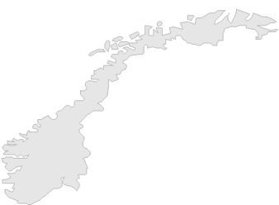
The Smart Tourism Destinations project
Promoted by the European Commission - DG GROW, the Smart Tourism Destinations Project is managed by Intellera Consulting, CARSA, the University of Malaga, and PwC EU Services.
The project aims to support EU destinations implementing data-driven approaches to make tourism more sustainable and accessible.
The project can also count on the support of 10 independent experts including private sectors practitioners and academic researchers.
SELECTED DESTINATIONS
48 Destinations have been selected to be part of the Project, having the possibility to learn from experts and peers and work on their Smart Tourism Destination’s Roadmap.
Gran Canaria (ES)
Fuerteventura (ES)
Azores (PT)
Notes:
Promoted by the European Commission - DG GROW, the Smart Tourism Destinations Project is managed by Intellera Consulting, CARSA, the University of Malaga, and PwC EU Services.
The project aims to support EU destinations implementing data-driven approaches to make tourism more sustainable and accessible. With the help of 10 independent experts including private sectors practitioners and academic researchers, destinations will learn how to improve tourism management through the use of data and of technological innovation.
48 Destinations have been selected to be part of the Project, having the possibility to:
Improve their data management skills for tourism
Learn from experts and peers
Improve their capacity to define or improve a roadmap to enhance the data-driven smart tourism capacity of the destination
These capacity building activities and materials will be partially available to the wider public, creating a community of practice of tourism stakeholders.

Slide 4
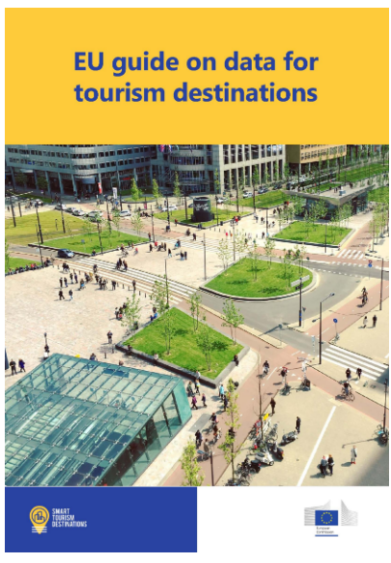
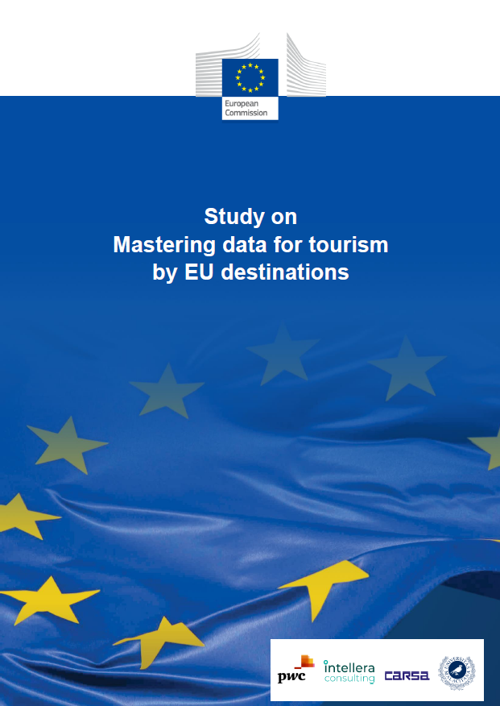
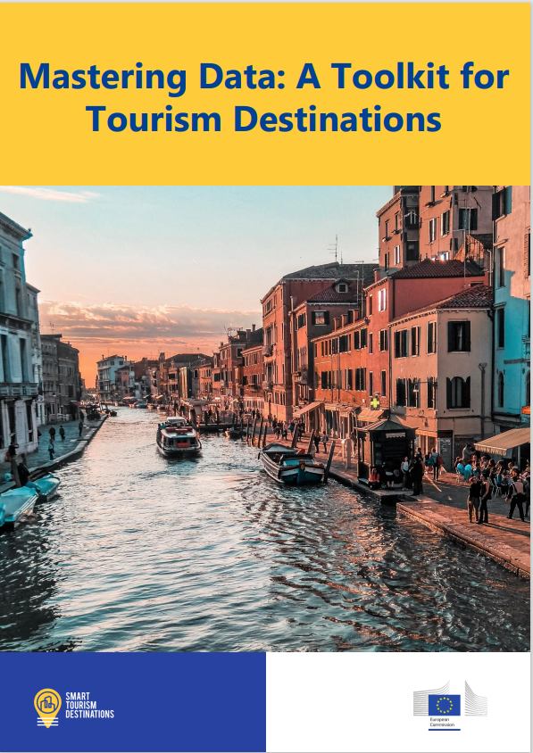
Resources from the project
EU Guide on data for tourism destinations
This guide on data for tourism destinations might therefore result useful for any type of destination willing to improve the way they collect and use data for tourism purposes and hopefully become inspirational for those cities, regions, or countries, eager to start their journey towards becoming smart tourism destinations.
Study on mastering data for tourism by EU destinations
The study provides an analysis of the state of the art on the use of data in the tourism sector in Europe and across the world. In addition, it offers a series of recommendations to catalyse the use of data by European destinations to improve their tourism offer.
Mastering Data:
A Toolkit for Tourism Destinations
The toolkit identifies four main steps, from exploring smart tourism as a concept to its concrete implementation.
Newly published on the Smart Tourism Destination Project website
Available for download on the project website:
https://smarttourismdestinations.eu/digital-library

Slide 5
The five pillars of a Smart Tourism approach
The five pillars of a Smart Tourism approach:
1
2
3
4
5
Strategy
and
Governance
Data collection, management and technological solutions
Human Capital and Skills
Knowledge Transfer
Ecosystem Management and Partnerships
Find the recording of Webinar 1, 2 and 3 and the material shared online on our website
Recordings and materials for Webinars 4 and 5 will be available on the Smart Tourism Destinations Project website soon after the event

Slide 6
Welcome to today’s webinar
This is the fourth webinar dedicated to the five pillars of the Smart Tourism Destinations Toolkit.
Webinar Objective: Highlight the importance of Knowledge Transfer in furthering the maturity of a Smart Tourism Destination.
This webinar supports knowledge sharing in selected subtopics of Pillar 4: “Knowledge Transfer”, providing examples linked to different maturity stages of Smart Tourism Destinations. A key case study of Gothenburg will be examined as part of this.
The Smart Tourism webinars aim to provide destinations with a strong theoretical background on the Smart Tourism Pillars while also giving concrete tips and examples. Our experts will diffuse key knowledge and information related to Pillar 4.

Slide 7
Speakers
Niklas Masuch
Project Manager, Destination Data Platform (DDP) at Gothenburg & Co
Travel tech professional with a background in Business Development and R&D specialized in customer insights (CRM/CDP).
Focus on digital transformation and how new technology can change, improve and not least simplify interaction and satisfaction with the customer/visitor.
Kristian Sievers
Senior Lecturer at Lapland University of Applied Sciences, and HAAGA-HELIA University of Applied Sciences, Finland.
Tomáš Gajdošík
Associate professor at the Department of Tourism, Faculty of Economics, Matej Bel University, Slovakia.
Tourism professional with extensive experience, having worked with tourism industry pioneers such as Disneyland Paris and Santapark in Rovaniemi.
Research focus: smart tourism, data analytics and tourism information technologies.
Closely cooperates several destination management organizations and public bodies.
Member of IFITT (International Federation for IT and Travel & Tourism) and AIEST (International Association of Scientific Experts in Tourism).
Focus on developing data driven smart tourism solutions to tourism destinations in Finland and internationally.

Slide 8
Knowledge Transfer in the Toolkit
Expert:
Kristian Sievers

Slide 9
Pillar 4 Introduction
Knowledge Transfer refers to the effective sharing of ideas, knowledge, or experience between people, companies, or organizations.
Pillar 4 places emphasis on the importance of real-time data analysis in enabling efficient co-decision making among stakeholders.
Knowledge Transfer for Smart Tourism destinations include components of data management, sharing, and analysis.
The use of digital technologies is a key aspect of Knowledge Transfer, such as:
Data management platforms
Data sharing toolkits
Open-source data environments

Slide 10
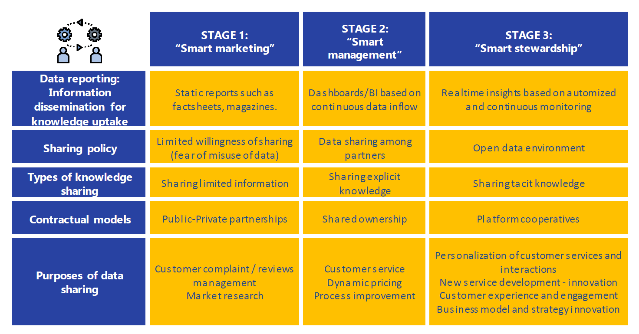
Key attributes of Pillar 4 – Knowledge Transfer

Slide 11
Challenges & Opportunities in Making Knowledge Transfer Smart
Expert:
Tomáš Gajdošík

Slide 12
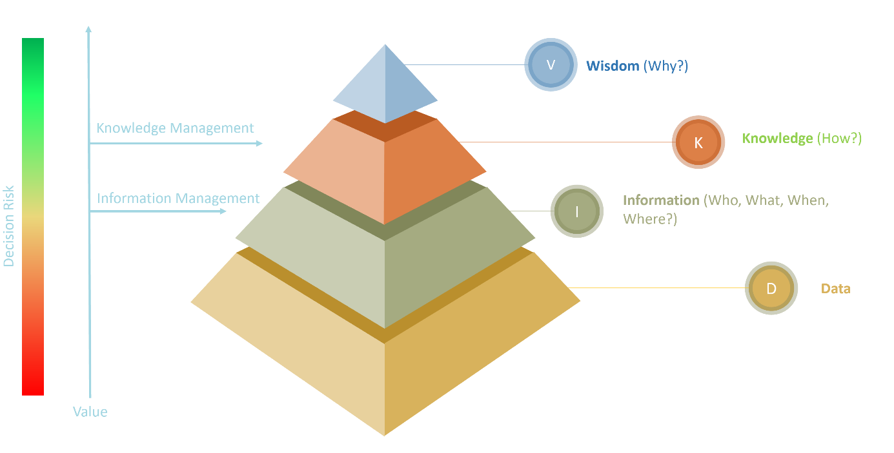
The DIKW pyramid
Knowledge has always been critical to innovation, productivity and competitiveness

Slide 13
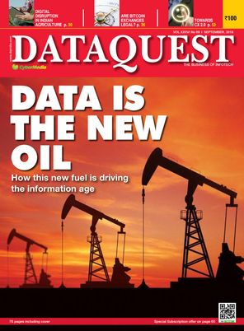
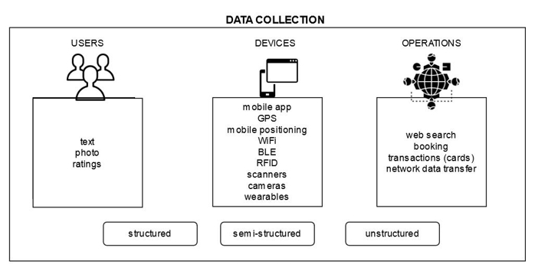
Data supporting smart tourism destinations
Data are the „new oil“ in the tourism industry
Data are created from abstraction and measurements taken from the world
Sources of data are constantly changing

Slide 14
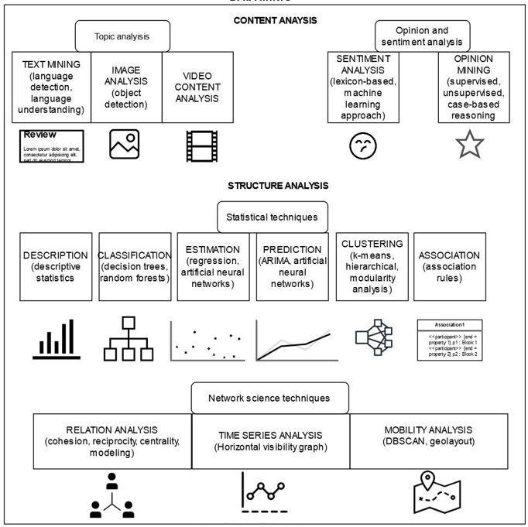
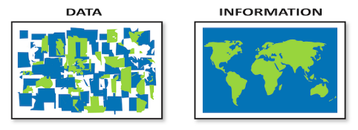
Creating information from data
Information is data that have been processed, structured or contextualized so that it is meaningful to humans

Slide 15
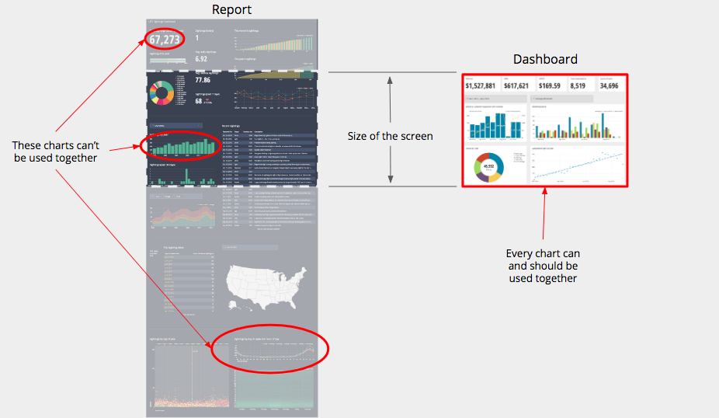
From information to knowledge
Knowledge is information that has been interpreted and understood by humans so that he/she can act on it if required.
Reports vs. dashboards

Slide 16
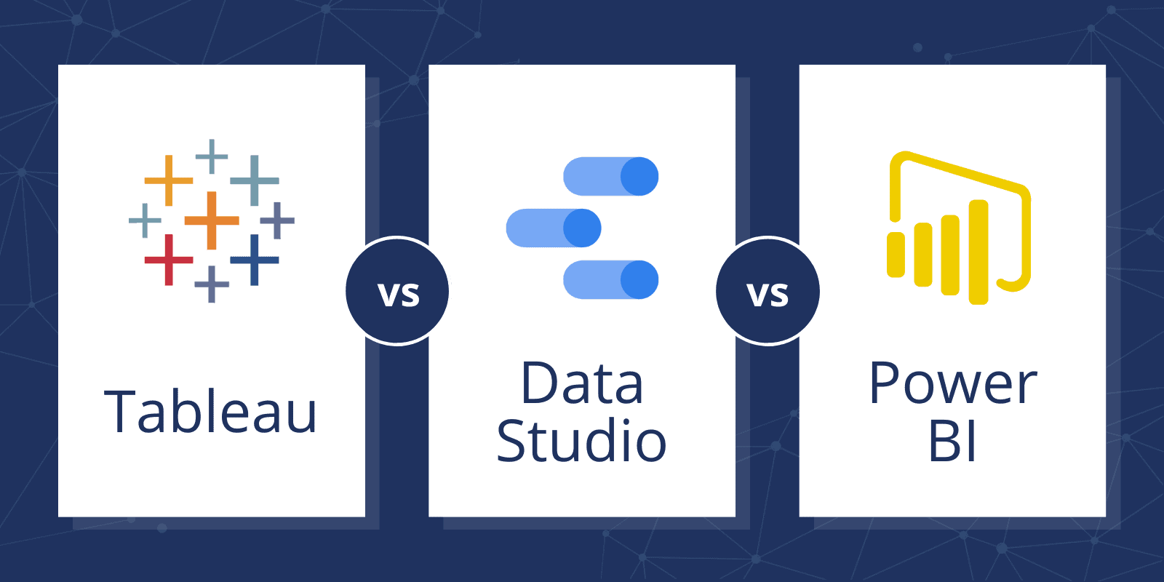
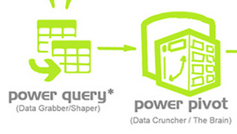
Tools for analysing and creating dashboards
Self-service business intelligence

Slide 17
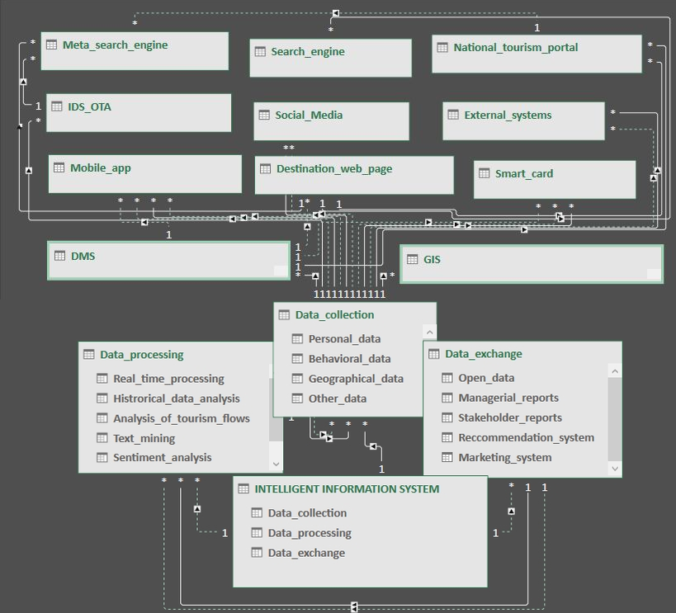
Knowledge transfer in smart tourism destinations
Sources of data vary, data owners are also different
Intelligent information system for smart tourism destinations
Gajdosik, Valeri, 2022

Slide 18
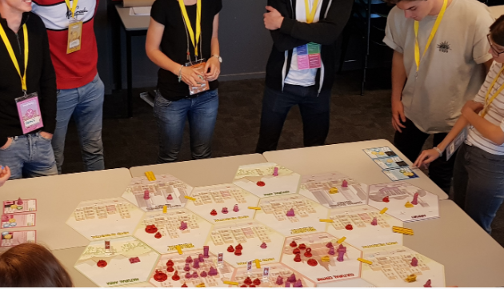
Challenges in knowledge transfer
The critical factor of effectiveness of knowledge transfer is the willingness of destination stakeholders to cooperate
Fear of leakages
Fear of misusing the data
Lack of confidence
Serious gaming as a one solution?
Barriers of data sharing
https://www.eduhub.ch/export/sites/default/files/Playful-Destinations-Presentation.pdf

Slide 19
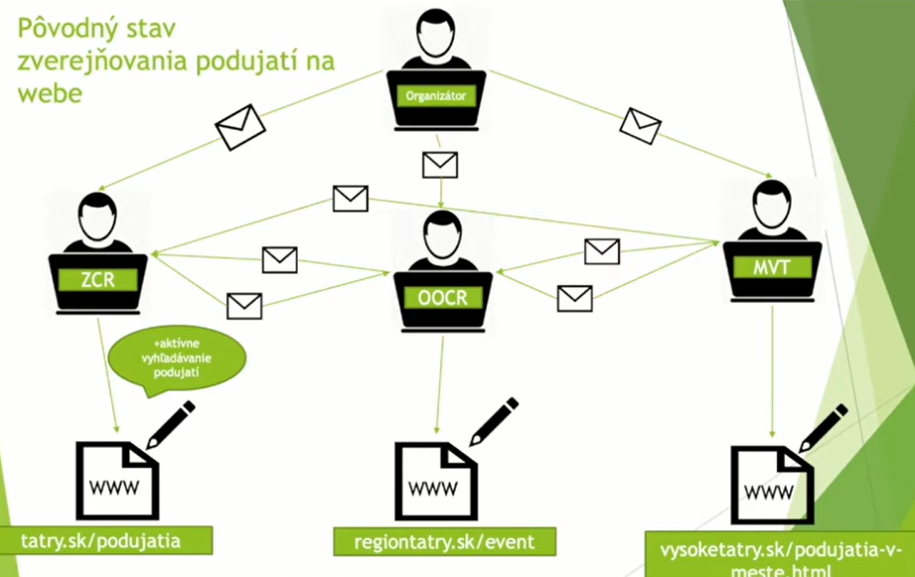
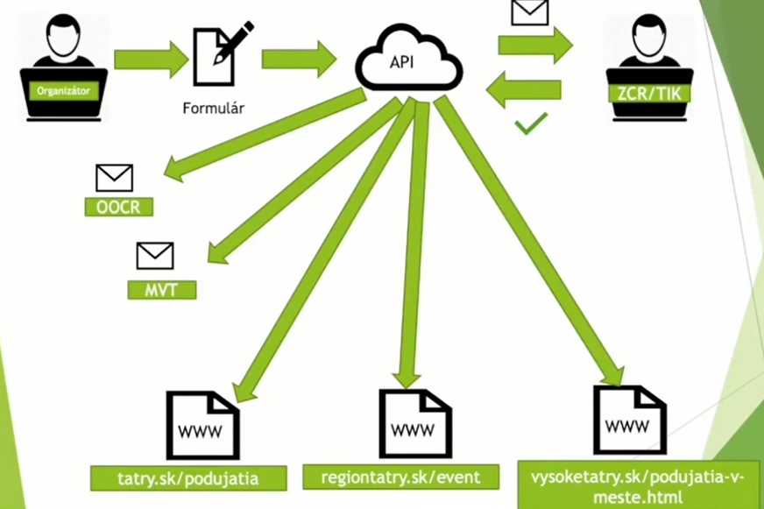
Challenges in knowledge transfer
Providing OPEN DATA ENVIRONMENTS ensuring transparency a supporting knowledge sharing
Open data drive innovation, improve public welfare and use resources more efficiently
Informing stakeholders via e-mail
Open data environment
https://www.tatry.sk/vysoke-tatry-na-konferencii-mesta-a-open-data-v-presove/

Slide 20
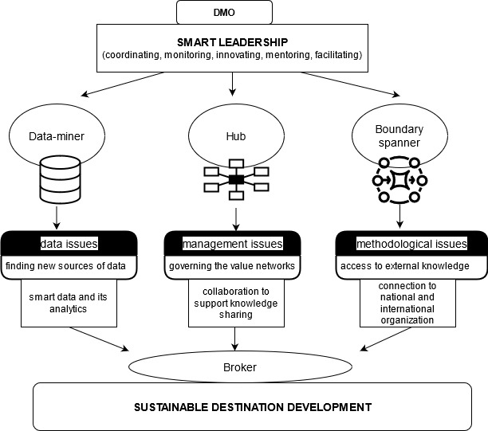
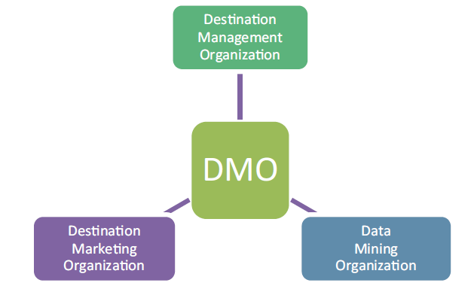
DMO as a leader in knowledge transfer
DMOs as data miners that allow data collection and analysis and linking different datasets from various stakeholders
DMOs as hubs that are able to gather and disseminate knowledge among destination stakeholders
DMOs as boundary spanners connect the destination network with the external world.
Marcis, Gajdosik, Gajdosikova, 2023 - forthcoming

Slide 21
New Tools for Knowledge Transfer : Case study of Gothenburg
Expert:
Niklas Masuch

Slide 22
Q&A
To ask questions, please click on the button in the bottom right corner of your screen.
Write your question.
Then write your name to send it off.
10 minutes
Notes:
Q&A session, 10 minutes 12:15 – 12:25

Slide 23
Next steps
Activity | Title | Date | Time (CET)
Pillar 5 webinar: Ecosystem management | Data and tourism ecosystems: from mapping to managing | 11/04/2023 | 11:30 – 12:30
Link to the webinars: https://smarttourismdestinations.eu/webinars/
Pillar 3 & 4 workshop Only for selected Tourism Destinations! | How to improve the Human Capital and Skills of your Smart Tourism Destination and foster knowledge sharing | 03/04/2023 | 13:00-15:00

