Slide 1








The future of work: new skills and profiles for Smart Tourism and how to get ready
27th January 2023
Pillar 3: Human Capital & Skills
Experts:
Marianna Sigala
Estrella Díaz Sánchez

Slide 2





Agenda – 27th January 2023
09:30 – 09:35 | Welcome and Objectives | Antonio Collado
09:35 – 09:45 | Introduction to Pillar 3 ‒Human Capital & Skills | Antonio Collado
09:45 – 10:00 | Subtopic 1: Skills in Smart Tourism | Marianna Sigala
10:00 – 10:15 | Subtopic 2: Leadership, Jobs & Capacity | Estrella Díaz Sánchez
10:15– 10:25 | Q&A session | Marianna, Estrella & Antonio
10:25 – 10:30 | Next steps | Antonio Collado
Note: To ask questions for the Q&A session, please use the chat function!

Slide 3
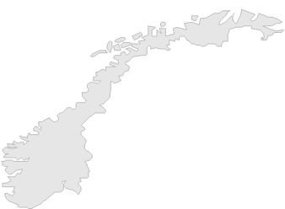




The Smart Tourism Destinations project
Promoted by the European Commission - DG GROW, the Smart Tourism Destinations Project is managed by Intellera Consulting, CARSA, the University of Malaga, and PwC EU Services.
The project aims to support EU destinations implementing data-driven approaches to make tourism more sustainable and accessible.
The project can also count on the support of 10 independent experts including private sectors practitioners and academic researchers.
SELECTED DESTINATIONS
48 Destinations have been selected to be part of the Project, having the possibility to learn from experts and peers and work on their Smart Tourism Destination’s Roadmap.
Gran Canaria (ES)
Fuerteventura (ES)
Azores (PT)
Notes:
Promoted by the European Commission - DG GROW, the Smart Tourism Destinations Project is managed by Intellera Consulting, CARSA, the University of Malaga, and PwC EU Services.
The project aims to support EU destinations implementing data-driven approaches to make tourism more sustainable and accessible. With the help of 10 independent experts including private sectors practitioners and academic researchers, destinations will learn how to improve tourism management through the use of data and of technological innovation.
48 Destinations have been selected to be part of the Project, having the possibility to:
Improve their data management skills for tourism
Learn from experts and peers
Improve their capacity to define or improve a roadmap to enhance the data-driven smart tourism capacity of the destination
These capacity building activities and materials will be partially available to the wider public, creating a community of practice of tourism stakeholders.

Slide 4
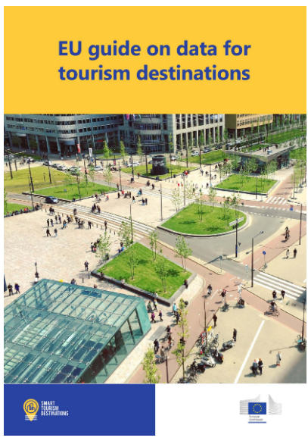
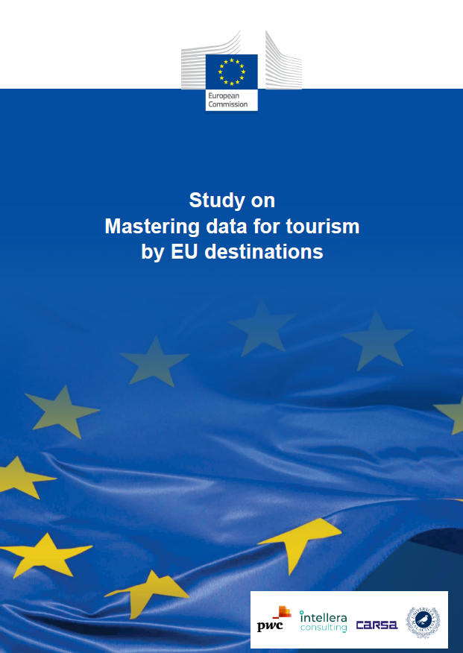
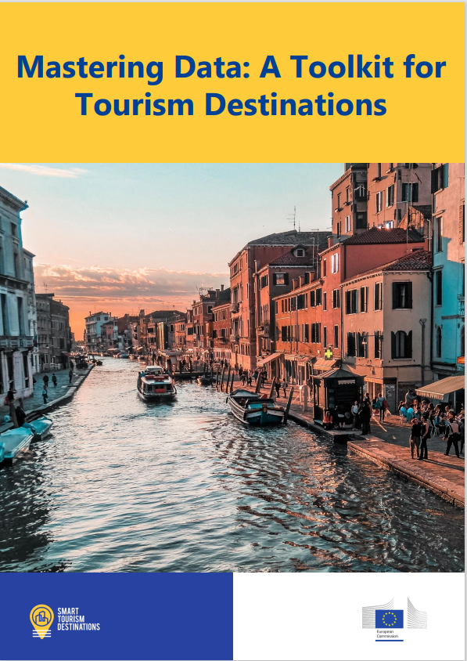
Resources from the project
EU Guide on data for tourism destinations
This guide on data for tourism destinations might therefore result useful for any type of destination willing to improve the way they collect and use data for tourism purposes and hopefully become inspirational for those cities, regions, or countries, eager to start their journey towards becoming smart tourism destinations.
Study on mastering data for tourism by EU destinations
The study provides an analysis of the state of the art on the use of data in the tourism sector in Europe and across the world. In addition, it offers a series of recommendations to catalyse the use of data by European destinations to improve their tourism offer.
Available for download on the project website:
https://smarttourismdestinations.eu/digital-library
Mastering Data:
A Toolkit for Tourism Destinations
Stay tuned!
To be published soon!

Slide 5





The five pillars of a Smart Tourism approach
The five pillars of a Smart Tourism approach:
1
2
3
4
5
Strategy
and
Governance
Data collection, management and technological solutions
Human Capital and Skills
Knowledge Transfer
Ecosystem Management and Partnerships
Find the recording of Webinar 1 and 2 and the material shared online on our website
Recordings and materials for Webinars 2, 3, 4, and 5 will be available on the Smart Tourism Destinations Project website soon after the event

Slide 6



Welcome to today’s webinar
This is the third webinar dedicated to the five pillars of the Smart Tourism Destinations Toolkit.
Webinar Objective: Highlight the importance of Leadership, Jobs, Capacity & Skills in furthering the maturity of a Smart Tourism Destination.
This webinar supports knowledge sharing in selected subtopics of Pillar 3: “Human Capital and Skills”, providing examples linked to different maturity stages of Smart Tourism Destinations.
The Smart Tourism webinars aim to provide destinations with a strong theoretical background on the Smart Tourism Pillars while also giving concrete tips and examples. Our experts will diffuse key knowledge and information related to Pillar 3.

Slide 7




Pillar 3 Introduction
Human Capital refers to ​the skills, knowledge and experience of a person or group of people, seen as something valuable that an organization or country can make use of.
Pillar 3 is an integral part of the Smart Tourism Destinations roadmap, enabling the implementation of Pillar 1 (Strategy & Governance) and Pillar 2 (Data Collection & Management).
Smart Tourism skills include digital competency, data analysis skills, and effective leadership.
Human capital and skills are essential for overcoming capacity restraints, in particular:
  Cooperation with universities and innovation hubs
  EU supports and resources (funding, jobs etc.)

Slide 8
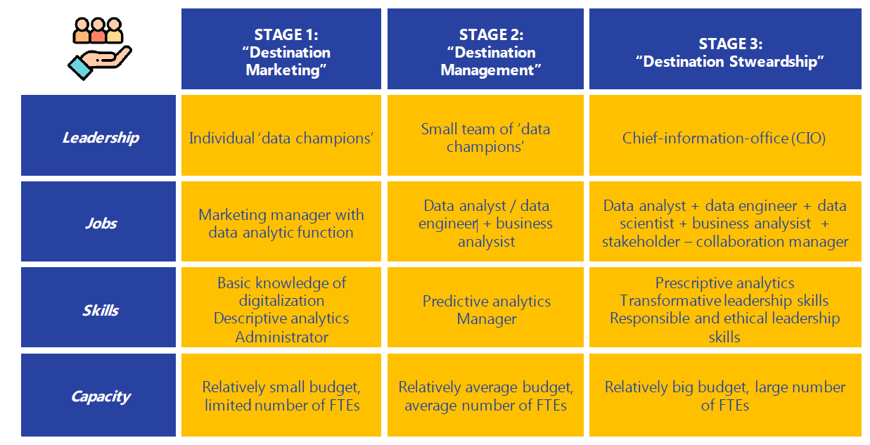
Key attributes of Pillar 3 – Human Capital and Skills

Slide 9
Experts
Marianna Sigala
Professor at University of Piraeus (Greece).
Estrella Díaz Sánchez
Researcher at University of Castilla-La Mancha (UCLM) , a Marie Sklodowska-Curie Senior Global fellow, and principal investigator of Horizon 2020 Project “Smart Tourism Challenges”.
Widely published (11 books & numerous papers)and Keynote speaker in international conferences.
Interest areas: Service & experience management, ICT in tourism and hospitality, and wine tourism.
International research projects e.g. EU, Council of Europe, Australian Dep. Foreign Affairs & Trade.
Research focus: consumer behaviour, tourism marketing, and new technologies.
Published over 35 papers, 1 book and 7 chapters.
Participated in research projects at EU, national and regional levels.

Slide 10

Skills for Smart Tourism
Expert:
Marianna Sigala

Slide 11

Big Data is the new oil of the smart economy
What skills do we need to use big data & become
smart destinations?

Slide 12
Two types of smart destinations (Boes et al. 2016)
hard smartness: netware, hardware and software investments
soft smartness: investments on innovation, human capital (knowledge and skills, leadership) and social capital (collaboration)

Slide 13
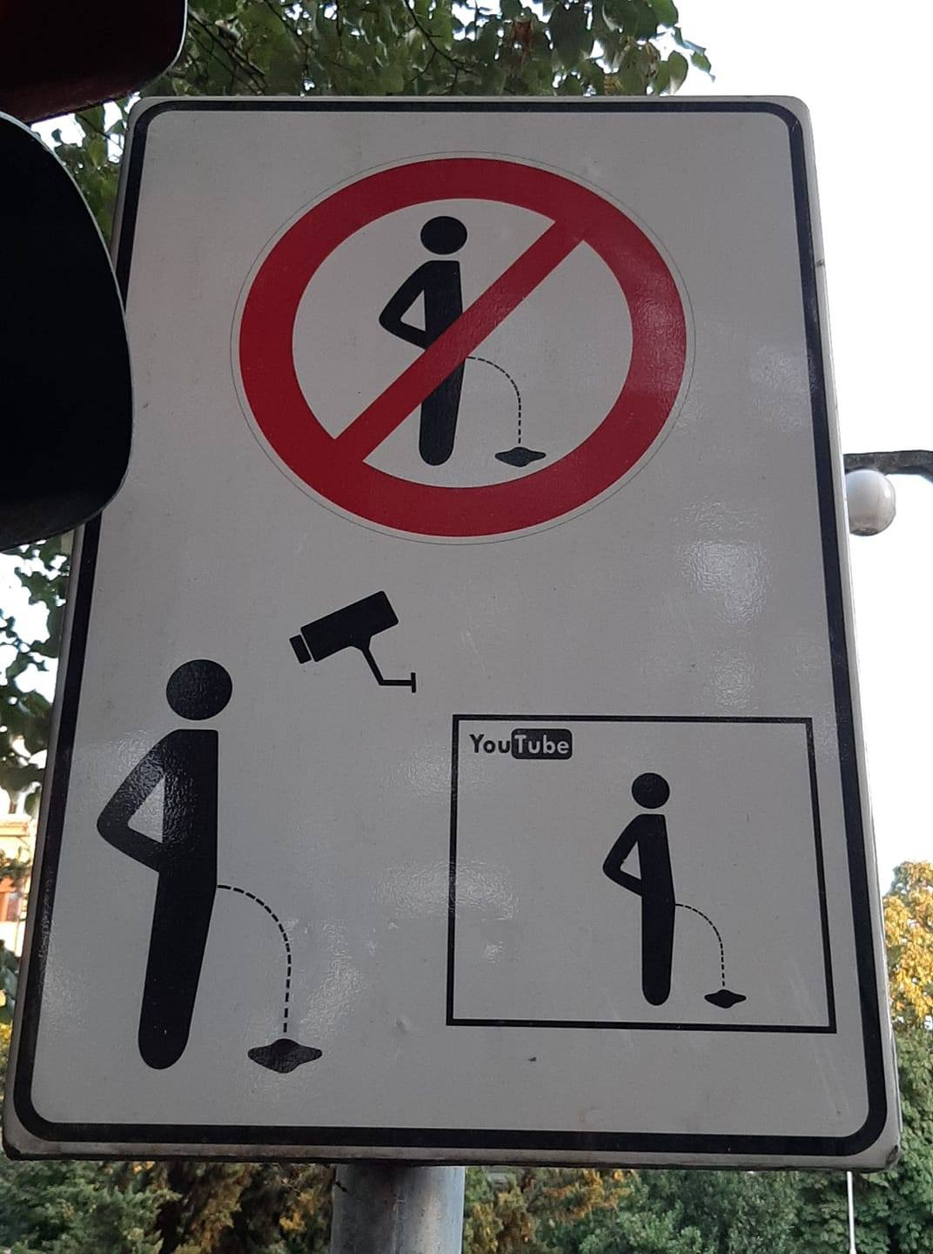
Innovation skills to use big data

Slide 14
Characteristics of Big Data V8

Slide 15
Two more socio-technical characteristics
Portability:
ability to transfer and remotely access big data from one application context to another
Big data are not usually captured for the reasons for which they can be potentially used.
Big data are captured once, but can be used multiple times and in various contexts.
Big data can be transferred and remotely accessed across technological platforms and organizational boundaries
Interconnectivity:
ability to go beyond the pre-existing templates of tapping isolated data sources by correlating and combining them in new ways
synthesized data are ‘greater’ than the sum of its individual parts

Slide 16
Big Data Skill: Identify types of data to be analysed
Photography
Geolocations
Blogs
Social media analytics
Web log data
Search engine data
Internet data

Slide 17
Big Data Skill: innovative use of type of data
Video Data:
Basic video analysis typically involves quantitative metrics such as number of users, response rate, subject, and location.
More advanced techniques include accessing video clips posted to social media sites, analyzing voice to determine emotional state of the user, and applying a behavioral model to spoken words to determine personality type of the user.

Slide 18
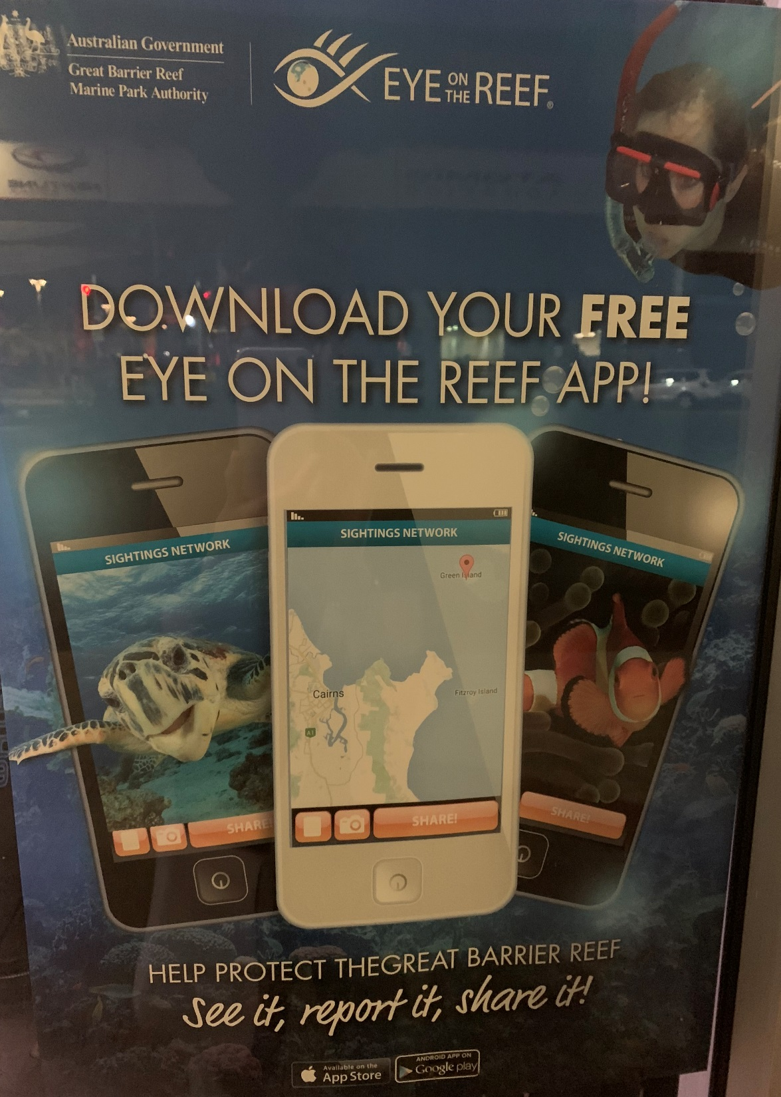
Big Data Skill: innovative in terms of data capturing source
Human sensors
Participatory sensing
Develop gamification applications ?

Slide 19
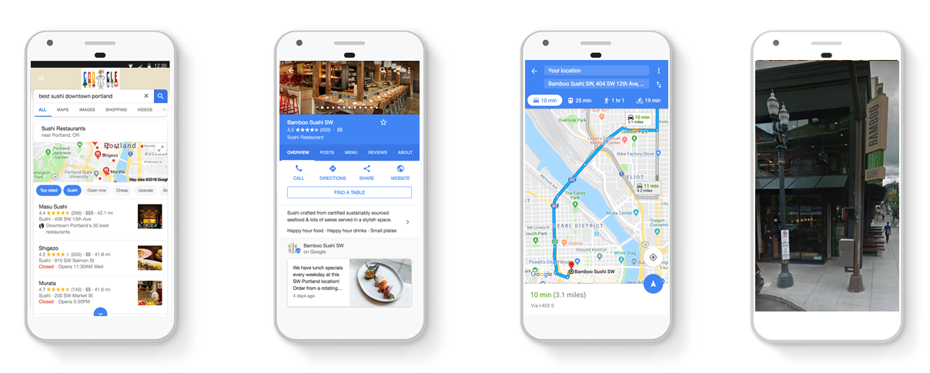
GOOGLE MAPS SEARCH DATA
THE CONSUMER JOURNEY
Search/Discovery
Decision/Action
Direction/Contact
Visit/Purchase
Notes:
And google tracks each action in the Maps platform. This cycle happens millions of times per day.
Phone 1 – counts as a view
Phone 2 – they viewed their listing
Phone 3 – direction request
Phone 4 – show up and purchase

Slide 20
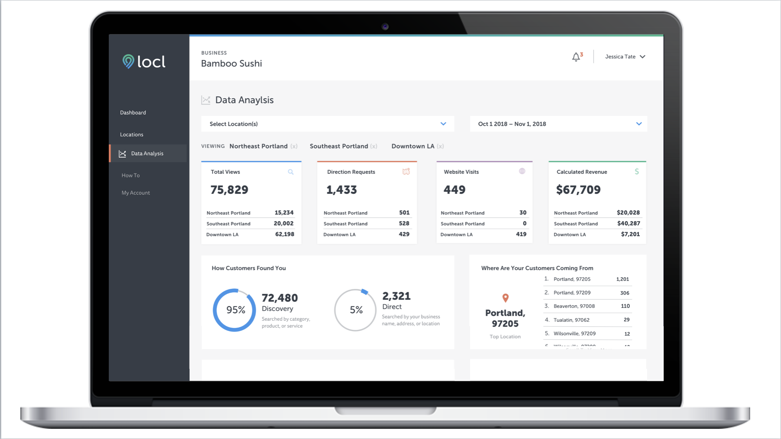

Slide 21
Big Data Skill:
Define the business problem:
why to use big data?
What business questions will you answer?
Investigate how people
explore, experience and engage with a destination
Analyse Big Data by aggregating real-time data :
  By business type (restaurant, hotel, retail, attraction, etc.)
  By neighborhood (Downtown, The Pearl, Hawthorne, Alberta, etc.)
  By event (meetings, events, conventions, festivals, Dining Month, etc.)

Slide 22
Business skills:
use data to improve business processes
ASK THE RIGHT QUESTION
Typology of
business questions based on social media
analytics

Slide 23
Big Data Skill: Data analytics & Data Science
Decide on types of data analytics
because they determine
what type of business questions you answer
Descriptive, “What happened?”
Diagnostic, “Why did this happen?”
Predictive, “What might happen in the future?”
Prescriptive, “What should we do next?”

Slide 24
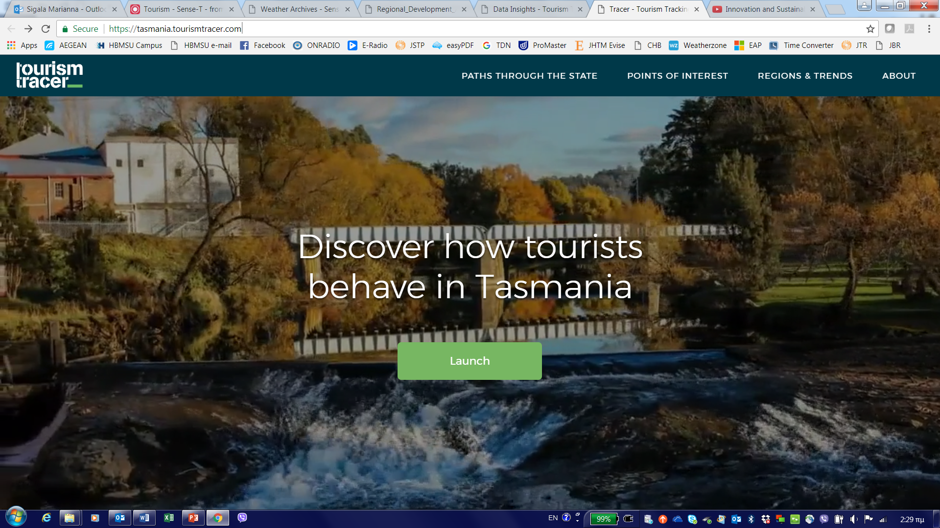

Slide 25
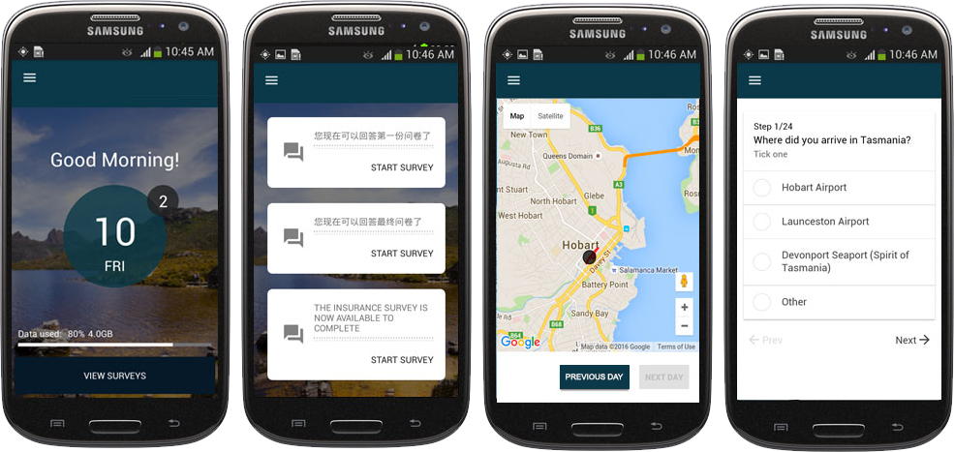
Notes:
Anne
What we do
Started Tasmania 2016- recruited 500 at 3 entry points-
App on a mbile phone bc poor WiFi- English and Chinese
Incentives:
Free data
TourTracer map
500: 2016
500: 2017
Tasmania: launched Standalone app- with social media synced Tour Tracer map….

Slide 26
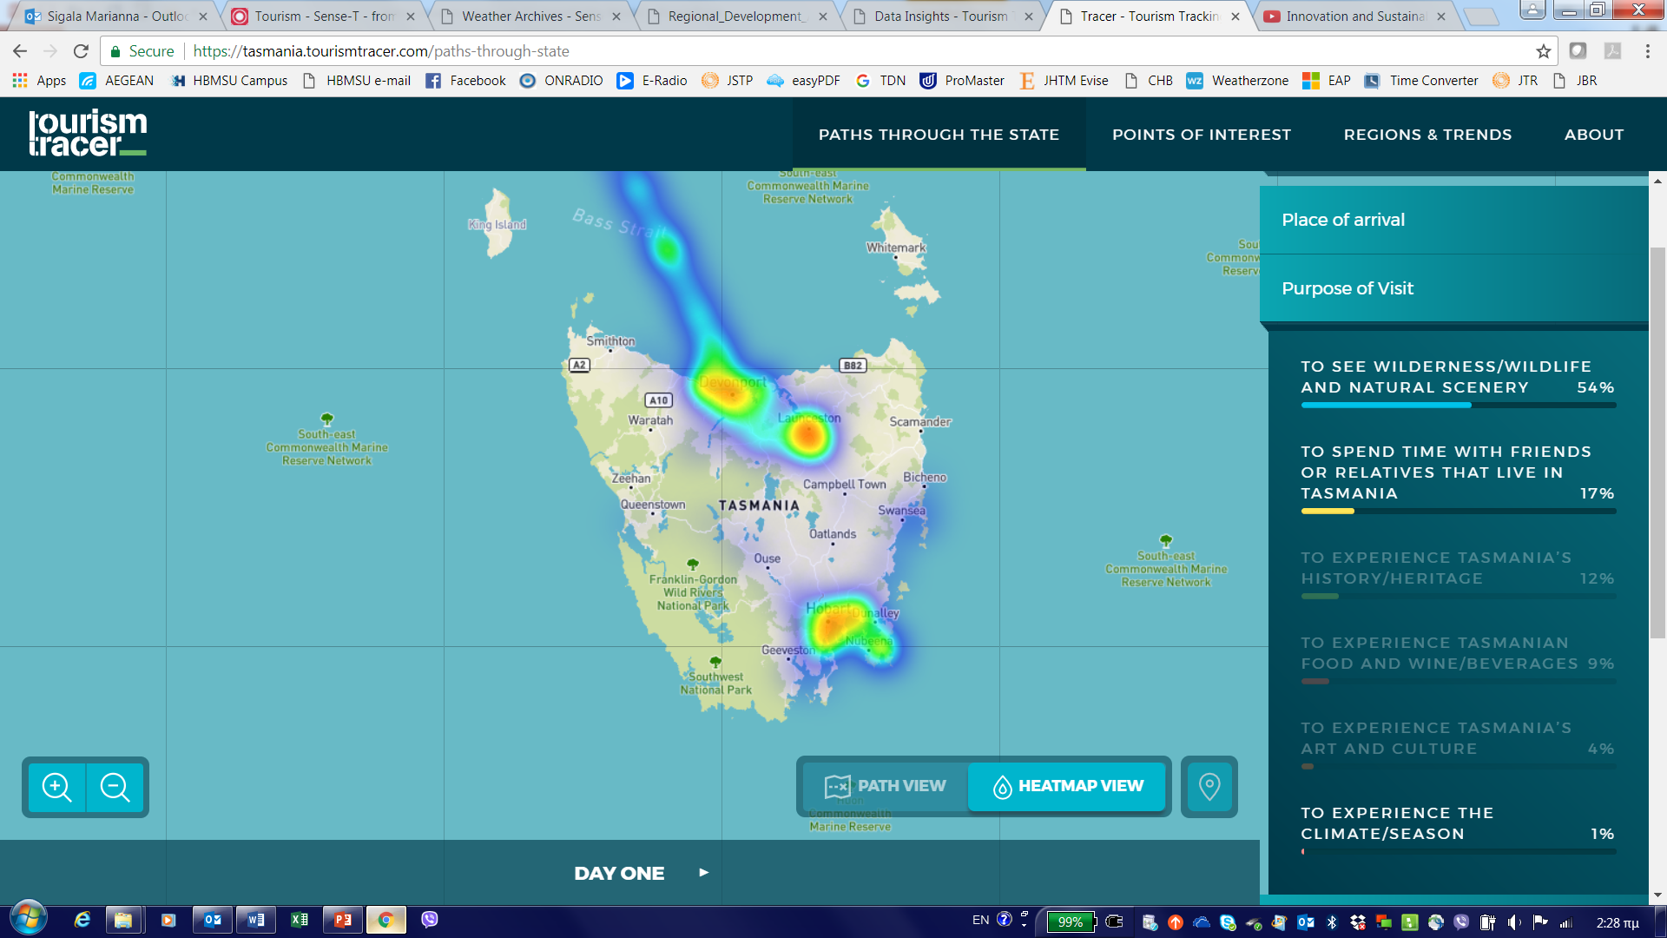
https://tasmania.tourismtracer.com/paths-through-state

Slide 27
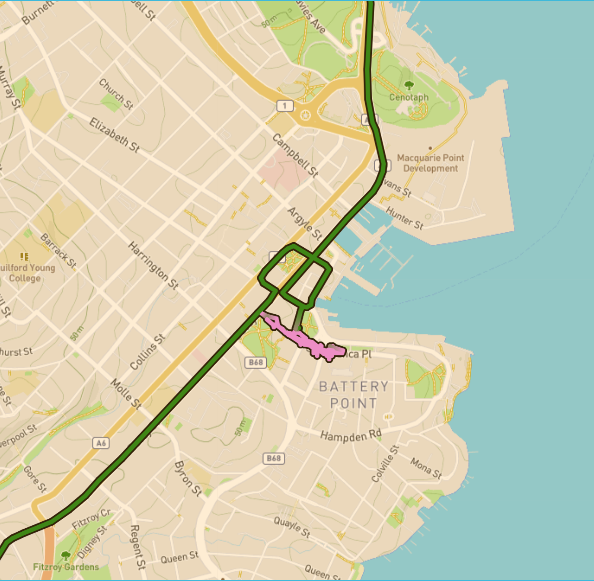
What does location tracking show?
Where tourists go and which attractions or businesses they interact with.
How long visitors stop in a location.
How fast they travel.
Which order do tourists do things in.
Notes:
How does location tracking beat asking tourists where they have been?
Can combine tourists locations with other data sets like the ATDW in Australia to show interactions between tourists and operators.
Road safety information

Slide 28
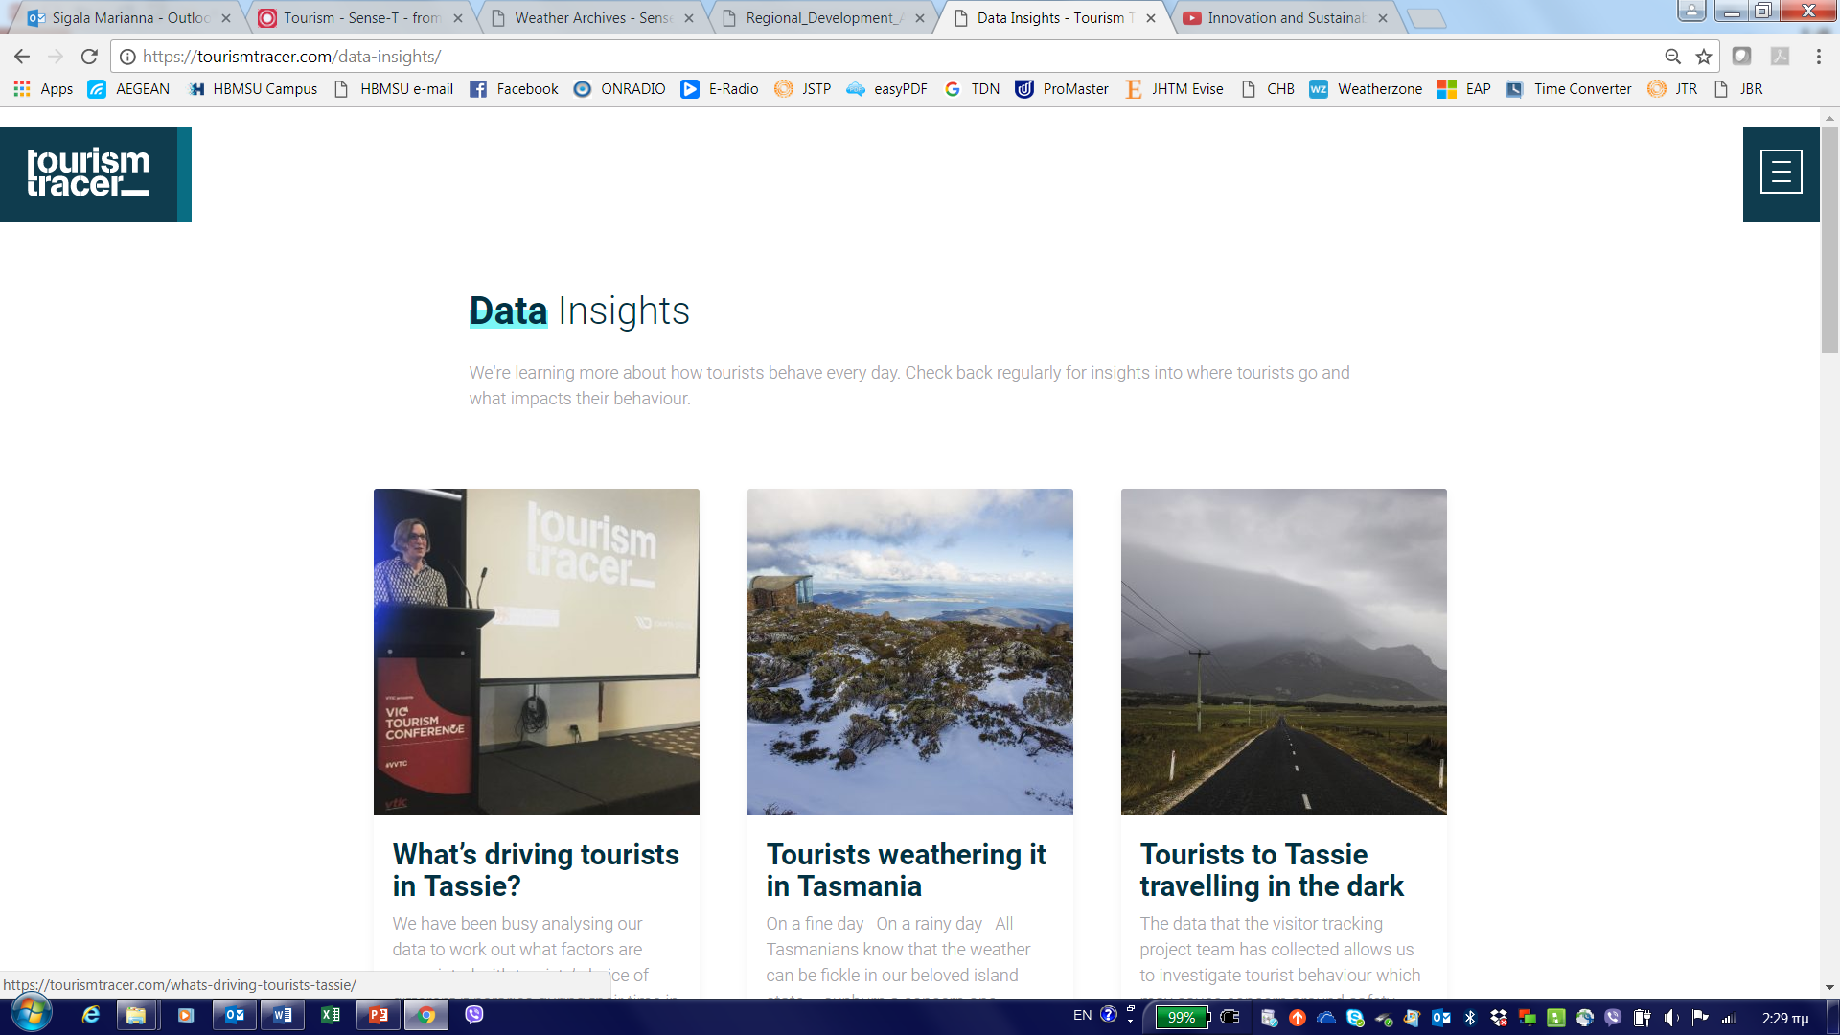

Slide 29
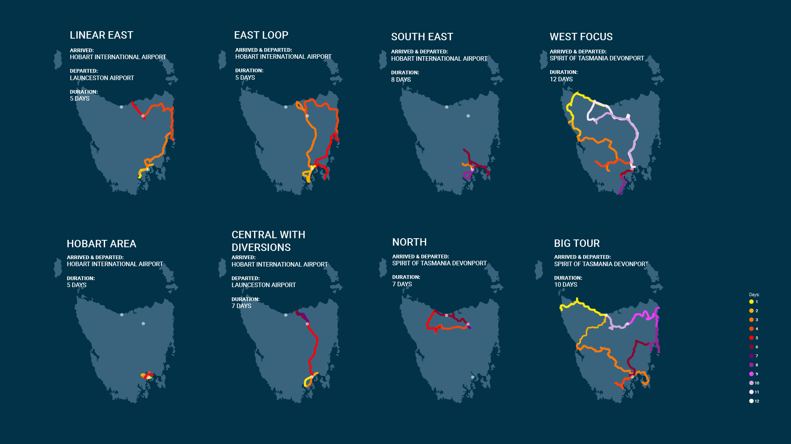
8 distinctive itineraries…
Notes:
Big tour: visited all major regions in TAS
West focus: spatially dispersed throughout the West (quite varied)
South East: did not leave the South East of TAS
Linear East: linear pattern through the East Coast
East loop: circular pattern through the East Coast
Hobart area: did not leave Hobart area
Central: drove through the centre with little diversions off Hobart and Launceston
North: quite varied group but their main characteristic is that no one in this group got as far south as Hobart.
Australians:
Most popular is Big Tour (19%) then South East (14%)
Then Central (11%) and East Loop (10%)
Linear 7% and Hobart area 3.7%
Chinese Visitors- small sample though
Most popular is Big Tour (14.3%) and South east (14.3%)
Then Central (9.5%) and East Loop (9.5%)
Hong Kong
East Loop (25.9%) then Linear East (22%)
South East (14.8%) then Central (7.4%)
Big Tour only 3.7%
Other International
Big Tour (23.7%) then South East (11%)
Linear East (9.3%) then East Loop (7.6%)
Linear East
In Hobart, out Launceston
In Launceston, out Hobart
In and out through Hobart
1st time visitors
Tasmania as the main but not the only destination
Big Tour
18-29 and 40-49 years old
60+ years old
52% In and out through Devonport
38 % in and out of Hobart
Length of stay (positive effect)
1st time visitors
Tasmania not the main nor the only destination
Car/4WD
Motorbike, bicycle, bus

Slide 30
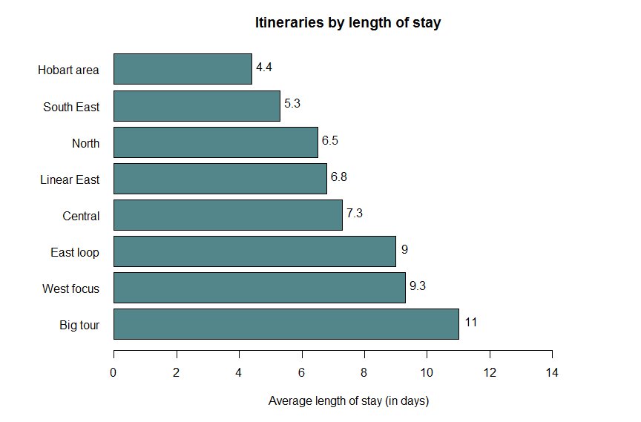
Length of stay in Tasmania

Slide 31

Usage of National Parks: Freycinet Case Study
Average time at lookout 13 mins
47% of phones then continued on to edge of beach
23% of phones were then recorded on beach itself
Photograph courtesy of Paul Fleming @LoveThyWalrus

Slide 32
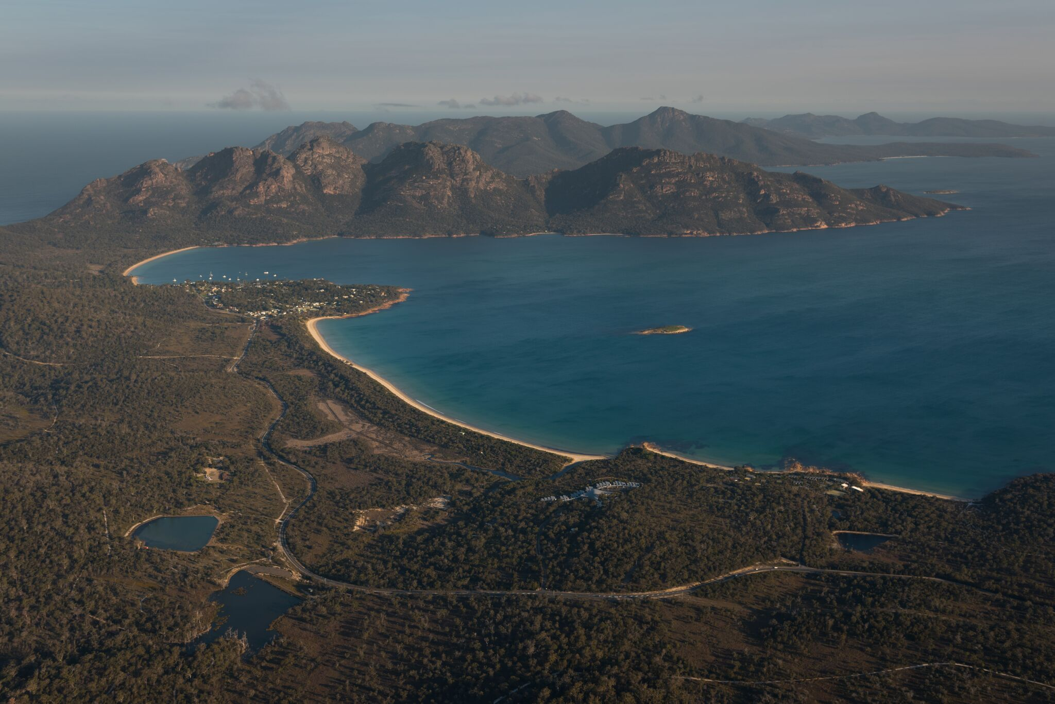
Car Park : 292,000 p/a
Peak time 11am-2.30pm
average stay 1.89hrs
average stay during peak: 2.3 hrs
Notes:
Car Park Situation
Incredible crowding
Average length of time 1.89 hours
Peak arrival time 11am
Average departure time 2.23pm
Interestingly, those who arrived in peak times tended to stay longer: 2.3 hours
Those 60 plus tend to use the car park during peak periods more others BUT much smaller cohot
Those below 29 and 40-59 avoid car park during peak BUT larger cohort
Fewer Chinese
Smaller groups stay longer
Those in peak times predominantly in Tas for Wildernerss and wildlife
Peak hour users tended to park long longer

Slide 33
Road Safety
C132 road between Devonport and Cradle Mountain
A 4 between St Marys and the Midlands Highway
A 9 between Sorell and Port Arthur
A3 between Sorell and the northern East Coast
Notes:
The analysis used cleaned data collected at 10 second intervals and involved an assessment of average travel speed of tourists relative to the posted speed limit, road form, and time of day (day time and night time). The analysis also explored the impact that place of origin and age of tourists had on travel behaviour.
The assessment further examined the percentage of tourists on each road system engaged in risk taking behaviour (travelling at 10km/hr above posted speed limit). The assessment was also undertaken with specific reference to place of origin as identified by tourists.
Average Speed (no graph): In the 100km/hr zone there appears to be little influence from place of residence, although Australians are generally faster on all roads. In contrast,
the 60km/hr zone results are more variable. On the C132 and A4 Chinese tourists travelled slower than other groups but on the A3 they appeared to travel faster in these zones.
A3- average speed of Chinese travelers in a 60 zone is 72km/hr
Graphs show the percentage of fast travelling tourists (travelling more than 10km/hr above the speed limit) on the four selected roads within the 100km/hr and 60km/hr zones again by reported place of residence. Speeding is more evident in slower speed zones. However, this trend is not as marked on the A4.
on A4 in 100km/hr zones - 20% of HK Visitors are more than 10km/hr above the limit on the A4
on A3 in 60km zones- 45% Chinese visitors are more than 10km/hr over the speed limit
Age did not have a major effect. - The main exception to this is the higher speed of 70+ tourists in 60 km/hr zones on the C132 and A9.

Slide 34
Big Data Skill: use data to improve organization wide performance
Should the destination bid and pay to host a (mega or local) event?

Slide 35
Big data driven investment decisions
Pre, post and during event spending (Spendmap)
Employment positions advertised (Seek)
Increased fitness levels (MapMyRun and Strava)
Quality of life - Community well-being (Neighbourlytics)

Slide 36
Big Data Skill:
use data to transform /redefine your business
UBER: taxi – technology company => Data provider
Nike: from shoe manufacturer to a data-driven fitness service
Netflix: from media distributor to media producer
DESTINATIONS: ?

Slide 37
eight areas that smart destinations seeks to improve:
Governance
Planning
Productivity
Innovation
Liveability
Wellbeing
Sustainability
Accessibility

Slide 38
Steps & skills for using big data
Identify a strategic policy issue / goal
Develop & set the questions to be answered
Establish a big data project team
Determine & define the variables to answer the questions
For each variable, identify indicators that can be measured
Identify the sources of data for each indicator

Slide 39
TO SUMMARISE: The big data skill set
The big data team
Business problem definition – leadership & DMO vision/goals
Data explorers: who filter data to identify usable information
Data are captured for different purposes of those that might be used
- Cash register data is a perfect example. Its original function was to allow companies to track revenue not to predict what product a given customer would buy next
Data hygienists: give form to unstructured data by ensuring that it is clean and accurate
One data set might be measuring calendar days in a year (365), another working days in a year (260), and yet another hours in a year (8765)
have old data fields been populated with new types of data but under the old field names?
Data scientists: creating predictive models from data
create sophisticated analytics models that, for example, help predict customer behavior and allow advanced customer segmentation and pricing optimization
Business solution architects: interpret data analyses results to yield actionable business insights

Slide 40
Big Data success factors
BIG DATA PARADOX
Business Value
Big Data
ICT INFRASTRUCTURE
Big Data QUALITY
Business Analytics CAPABILITIES
CREATIVITY
Big Data Leadership
Data partnerships
ORGANISATIONAL CULTURE
POLICY
COMPETITIVE CONTEXT

Slide 41
Human Capital:
Leadership, Jobs & Capacity
Expert:
Estrella Díaz Sánchez

Slide 42
Outline

Slide 43
Human capital and skills in Smart Tourism Destinations
We live a moment of change.
Changes in the demographic structures, environment and changes caused by technology have a decisive effect on the future of work.
Tourism Destinations should consider human capital and skills to became smart tourism destinations.

Slide 44
Human capital and skills in Smart Tourism Destinations
 | STAGE 1: Destination Marketing | STAGE 2: Destination Management | STAGE 3: Destination Stewardship
Leadership | Individual "data champions | Small team of "data champions" | Chief-Information-Office (CIO)
Jobs | Marketing manager with data analytic function | Data analyst/data engineer + business analysist | Data analyst + data engineer + data scientist + business analysist + stakeholder – collaboration manager
Skills | Basic knowledge of digitalization. Descriptive analytics Administrator | Predictive analytics manager | Prescriptive analytics Transformative leadership skills Responsible and ethical leadership skills
Capacity | Relatively small budget, limited number of FTEs | Relatively average budget, average number of FTEs | Relatively big budget, large number of FTEs

Slide 45
LEADERSHIP

Slide 46
Data-driven culture to create leadership
Data culture is conceptualised as the beliefs and behaviours related to data that influence the way a destination operates.
Effort and
coordination
of different
stakeholders
and users
Meeting the
needs
of the
destination's stakeholders
Destination
manager
support

Slide 47
Initiatives of data-driven culture
 | STAGE 1: Destination Marketing | STAGE 2: Destination Management | STAGE 3: Destination Stewardship
Leadership Competence | Position data analytics as a future core Importance of the communication. Create competency of senior management on data analytics. Use case studies. | Embark on data analytics projects, support teams and push for resources. Active use of data analytics, metrics or dashboards. | Have clear vision and strategy for data analytics aligned with both destination and IT strategy. Sponsor all data analytics initiatives providing all resources needed.
Team Structure | Get informed on typical data analytics team structures, what they consist of, their roles, purposes and how it can be useful for the organisation (in-house or outsourced). Get informed on data champion meaning. Inform how data champions can be useful. | Form in-house data analytics and data governance team. Include data-analysts, scientists, engineers and controllers. Create community of data analytics champions. Enable community to share data analytics skills, success stories, and participation in mini challenges. Offer foundational courses and annual workshops. | Drive data analytics efforts across all destination units through a centralised shared services hub and spoke model with dedicated data analytics team. Have formal data owners and stewards that manage data life cycle management.
Skills | Conduct basic brief skills audit. Gauge initial skill levels in terms of data analytics across the organisation (i.e. online survey). | Conduct skills audit. Online surveys, in-depth sessions with data champions | Introduce advanced analytics trainings. Train machine learning, AI or natural language processing.
Human Resources Management | Trainings on data analytics skills for basic data processing (internal/external). Initial info sessions on the basics of data analytics via virtual training. | Encourage data analytics team to block time to attend advanced data analytics training courses. Educate about data analytics. | Have good understanding of data analytics through the use of cases. Data analytics training courses.

Slide 48
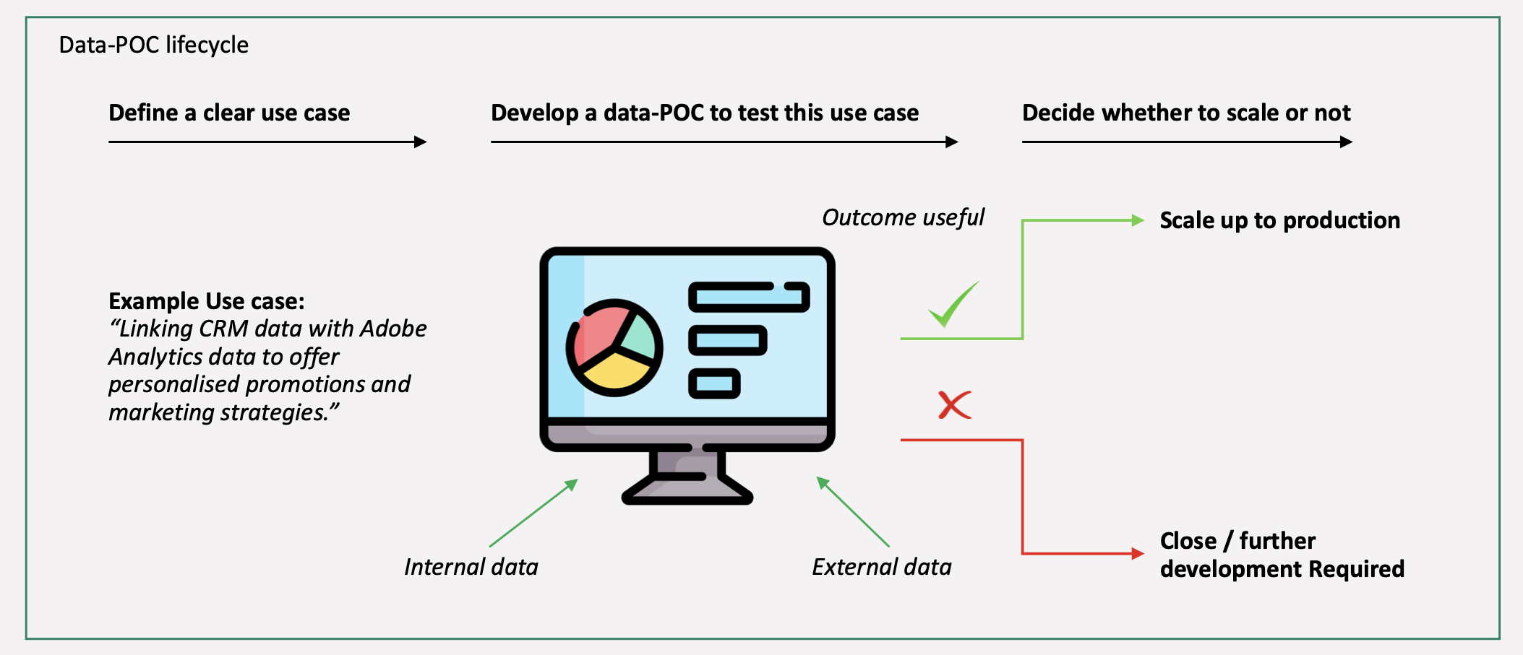
A Data-Proof of Concept (PoC)

Slide 49
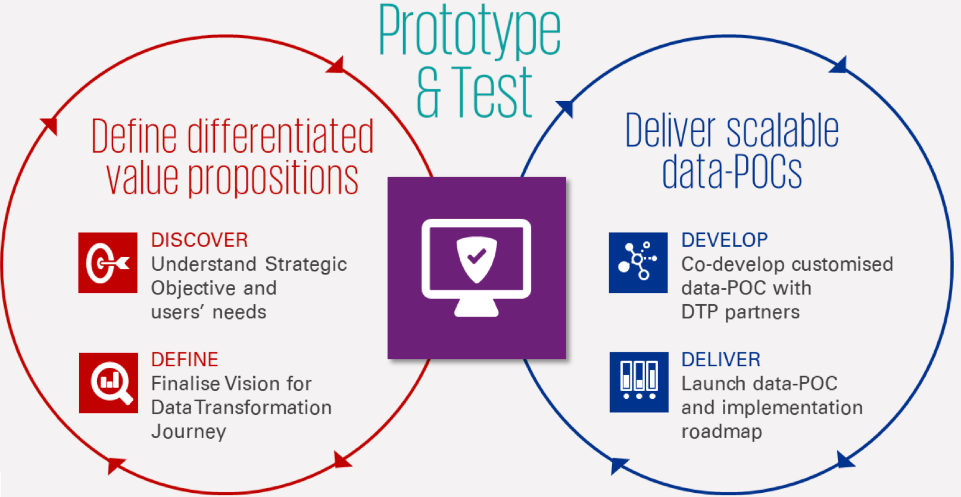
A Data-Proof of Concept (PoC)

Slide 50
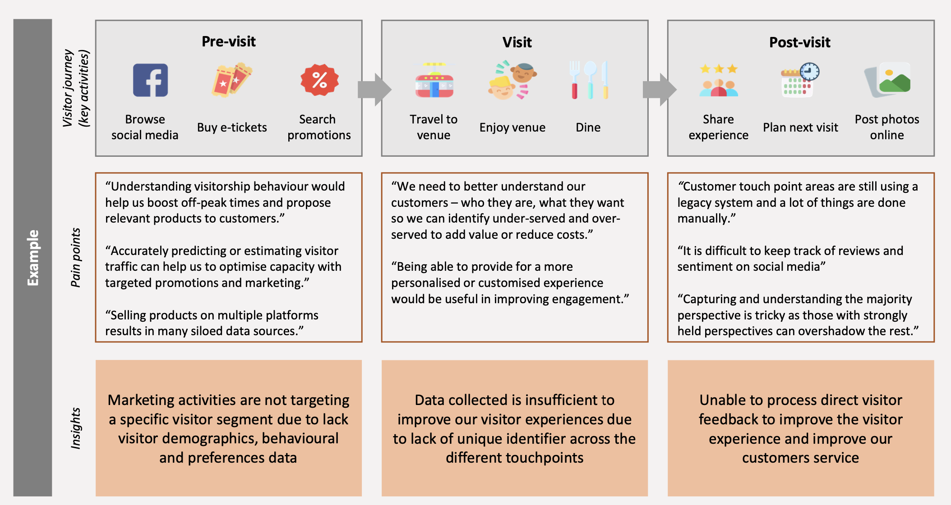
Example: Discover

Slide 51
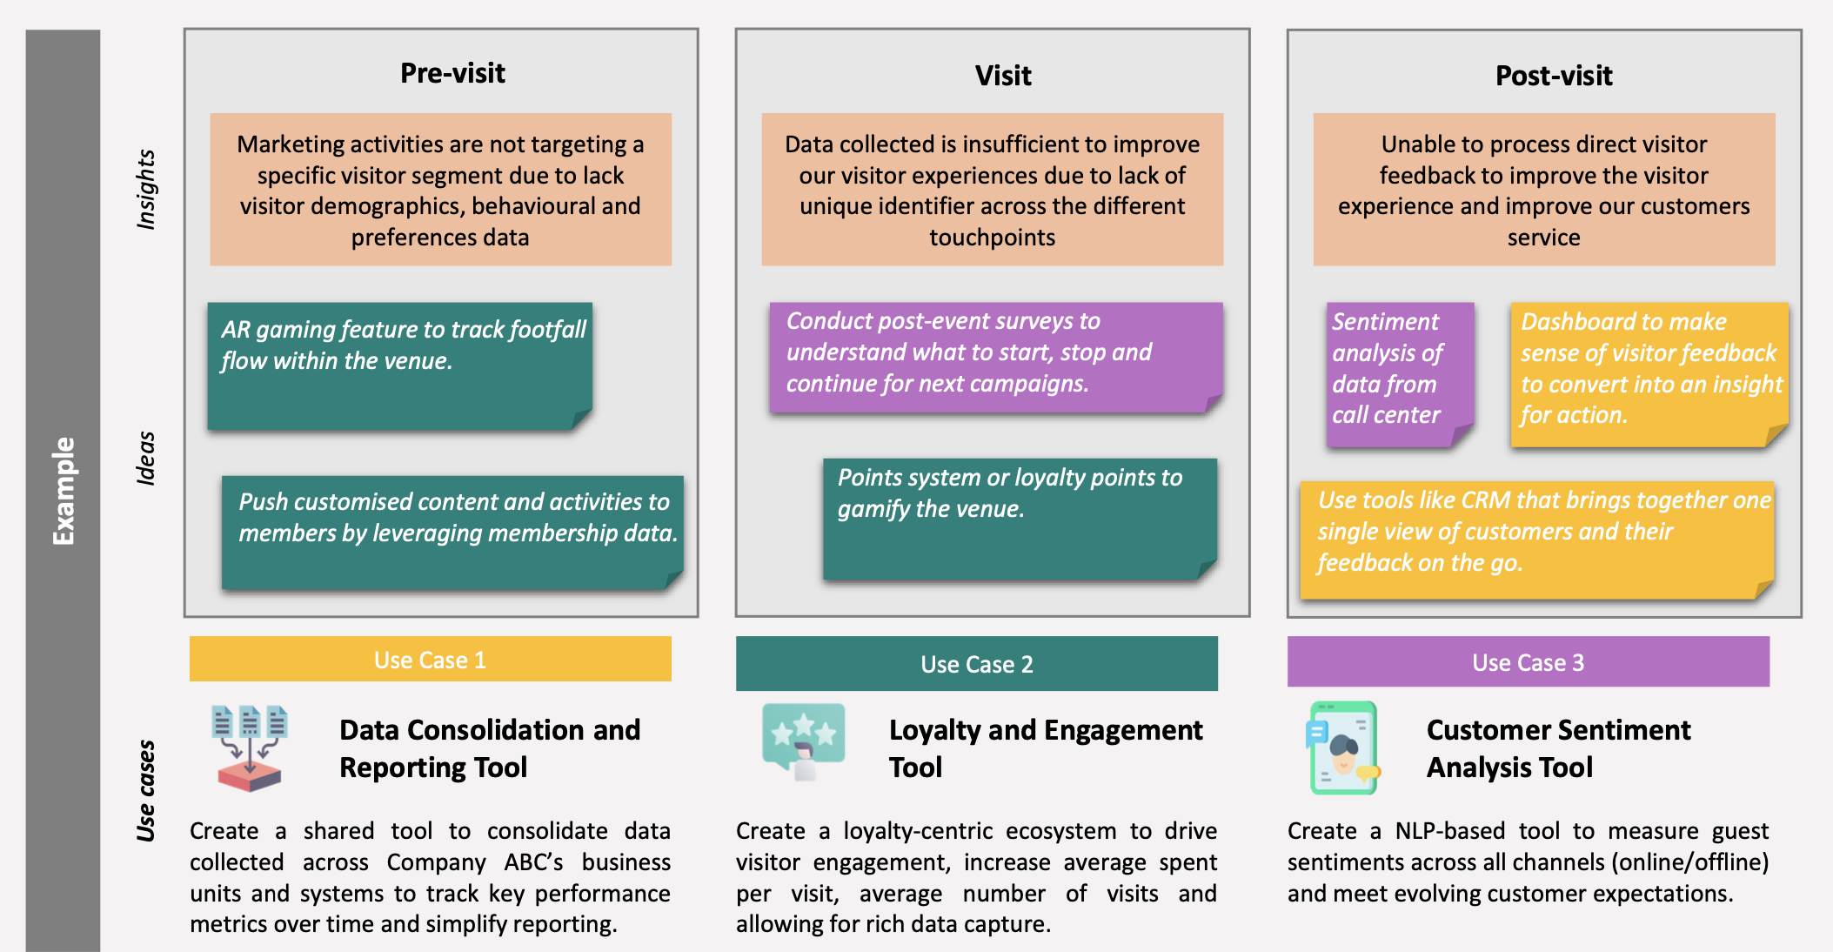
Example: Define

Slide 52
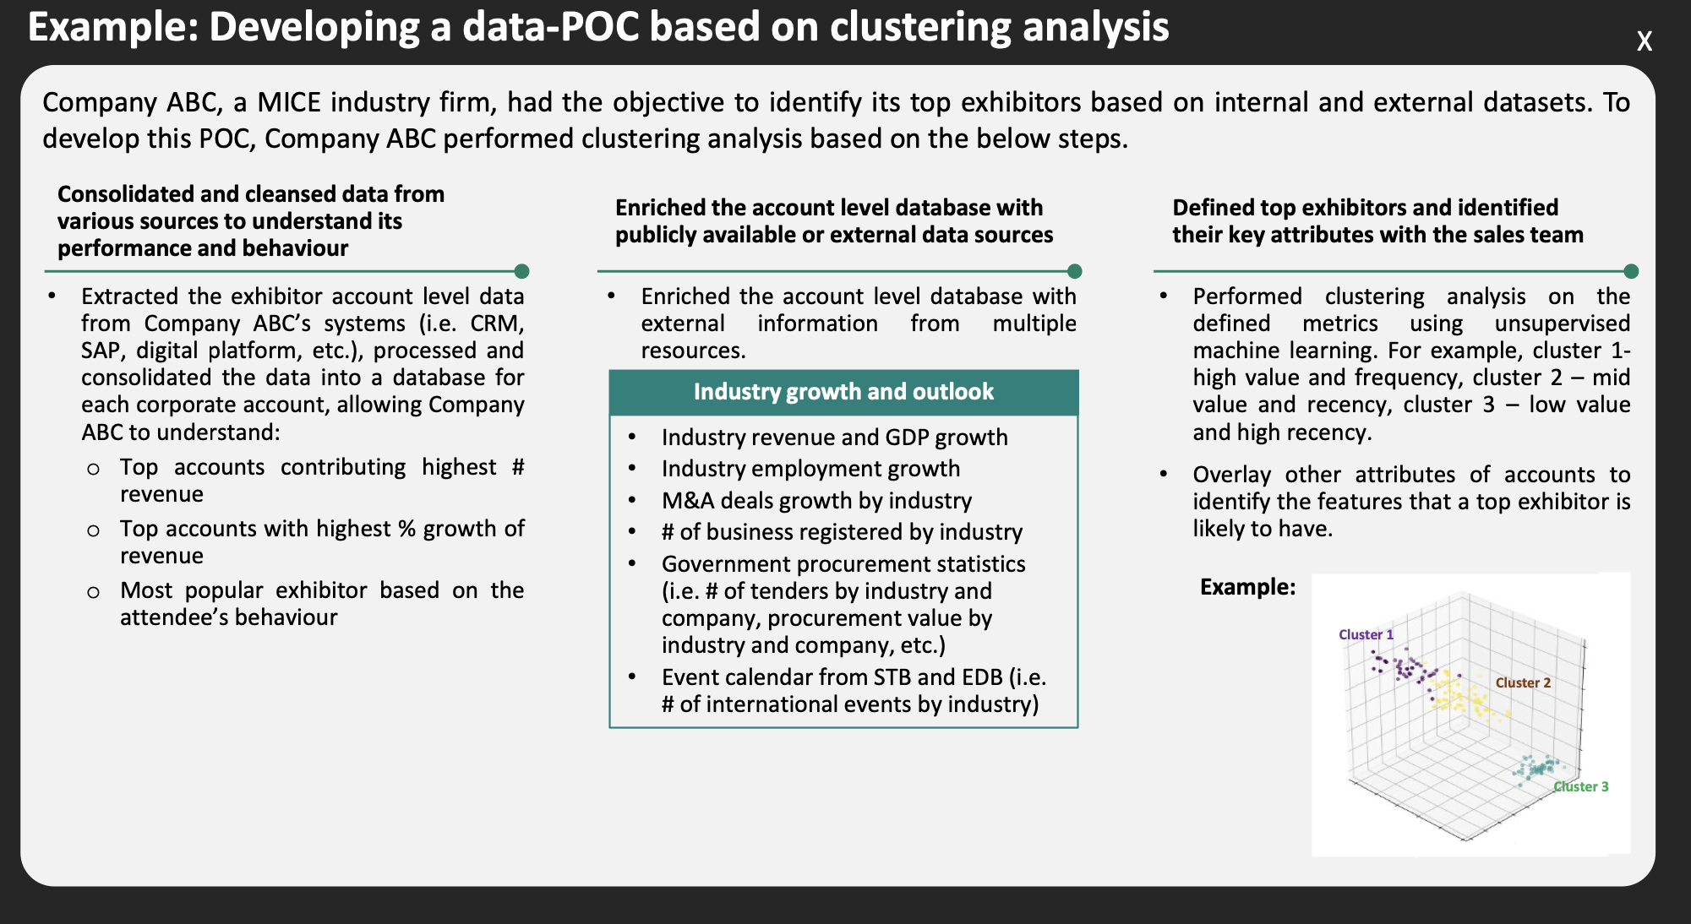
Example: Develop

Slide 53
"Data champions": Destination Marketing/Destination Management
“Data champions” are individuals who are passionate about using data effectively and who promote data best-practice. They are essential in their company’s journey to becoming data-driven. Empowering data champions is not just for companies with mature data cultures.
THREE questions to consider:
How to identify data champions? Recognising people who are data enthusiasts and keen to evangelise its value is extremely helpful as companies go through change to become more data-driven.
What’s the role of a data champion? While the employee should take the lead on defining the role, they should do so in partnership with the DMO to understand the big picture of how their role supports the destination’s data strategy.
How can the destination empower them? Recognition and training. RECOGNITION: by giving the data champions a voice internally and externally. Externally, offering networking and speaking opportunities at external industry events, where they can learn, share and be inspired. Internally, bringing together data champions to offer input about data-driven initiatives. It requires a shift in mindset and daily habits. TRAINING: Giving them access to e-learning tools, certification programmes or vendor events will raise the bar on their skills, while continuing to inspire and motivate them in their work.

Slide 54
Chief-Information-Office (CIO): Destination Stewardship
CIOs hold some of the most challenging roles in destinations, with responsibilities for creating value that extend far beyond traditional information technology support and delivery. The CIO’s role has shifted from being a steward of technology to a partner in shaping the future of the business.
CIOs can support the process of improving data quality, accessibility, and traceability. They play an important role in enabling that [by] positioning the destination to provide data and insight to the stakeholders. As technology leaders, CIOs with vision, communication skills, and relationships are well positioned to command more influence and help their destinations thrive.
CREDIBILITY
• Developing rapport
• Building trust
• Becoming a partner to the business
VALUE
•Leading with resiliency
•Understanding the evolving role of the CIO
•Impacting destination results
INFLUENCE
• Storytelling
• Using strengths to influence
• Developing an exclusive mindset
The CIO should develop three key pillars:
Value
Credibility
Influence

Slide 55
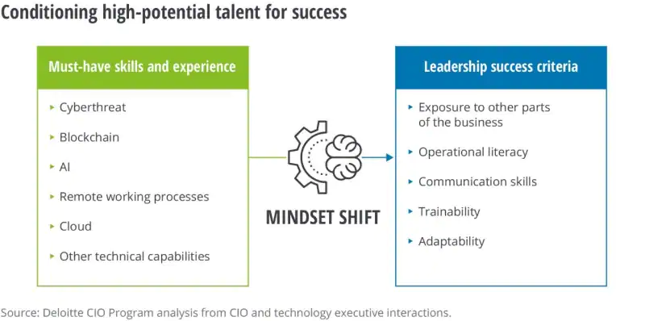
Chief-Information-Office (CIO): Destination Stewardship
Future CIOs and technology leaders must have technical backgrounds and skill sets.

Slide 56
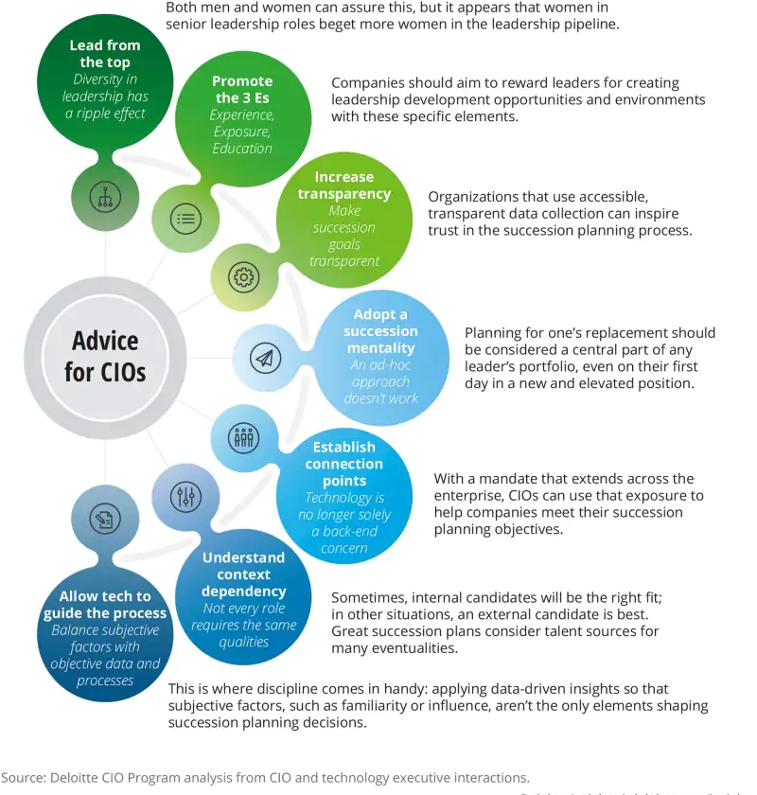
Chief-Information-Office (CIO): Destination Stewardship
Recommendations for CIOs.

Slide 57
JOBS

Slide 58
Jobs
As a human capital intense sector, tourism is highly affected by the current social and technological transformation which are shaping new business models, consumer’s patterns, changing value chain structures and demand/supply dynamics.
As a result, what are the main challenges and characteristics of the future of work in tourism?

Slide 59
Jobs
The emerging technologies most likely to impact jobs and skills in the tourism industry include digital platforms, virtual reality (VR), augmented reality (AR), artificial intelligence (AI), big data, automation and service robots, and other emergent advanced technologies.
Work organisation impacts from digitalisation have so far been accommodated largely within existing occupational and job structures.
Machine-based learning, task automation and robotics have considerable potential for job displacement in tourism. This is already evident for low-skilled service workers in some countries but the scale of early job displacement across the sector is likely to be constrained by certain cultural factors, including customer resistance in some regions.
AI and Big Data can boost personalised travel but raise challenges (and customer concerns) about personal data protection, which, in turn, calls for greater workforce awareness of personal information sharing, skills to support cyber-security and better privacy protection.
Emergence of new types of jobs in tourism. Computer systems analysts is featured as occupations most in demand. Other recurrent occupational needs for digitalisation in the sector are database administrators and programmers. There is an emerging demand for robot ‘trainers’ as specialists in programming, managing fixed and mobile robots and for VR and AR ‘area’ designers.

Slide 60
Example
Destination: France
France confirms a need for numerical competence as being indispensable for tourism enterprises today.
Destination: Germany
Germany indicated an expectation that digitalisation will expand the numbers of ‘numerate’ tourism jobs especially in data management, manipulation, and analysis, as well as others where the focus was on rising demand for content production and management and mobile applications.

Slide 61
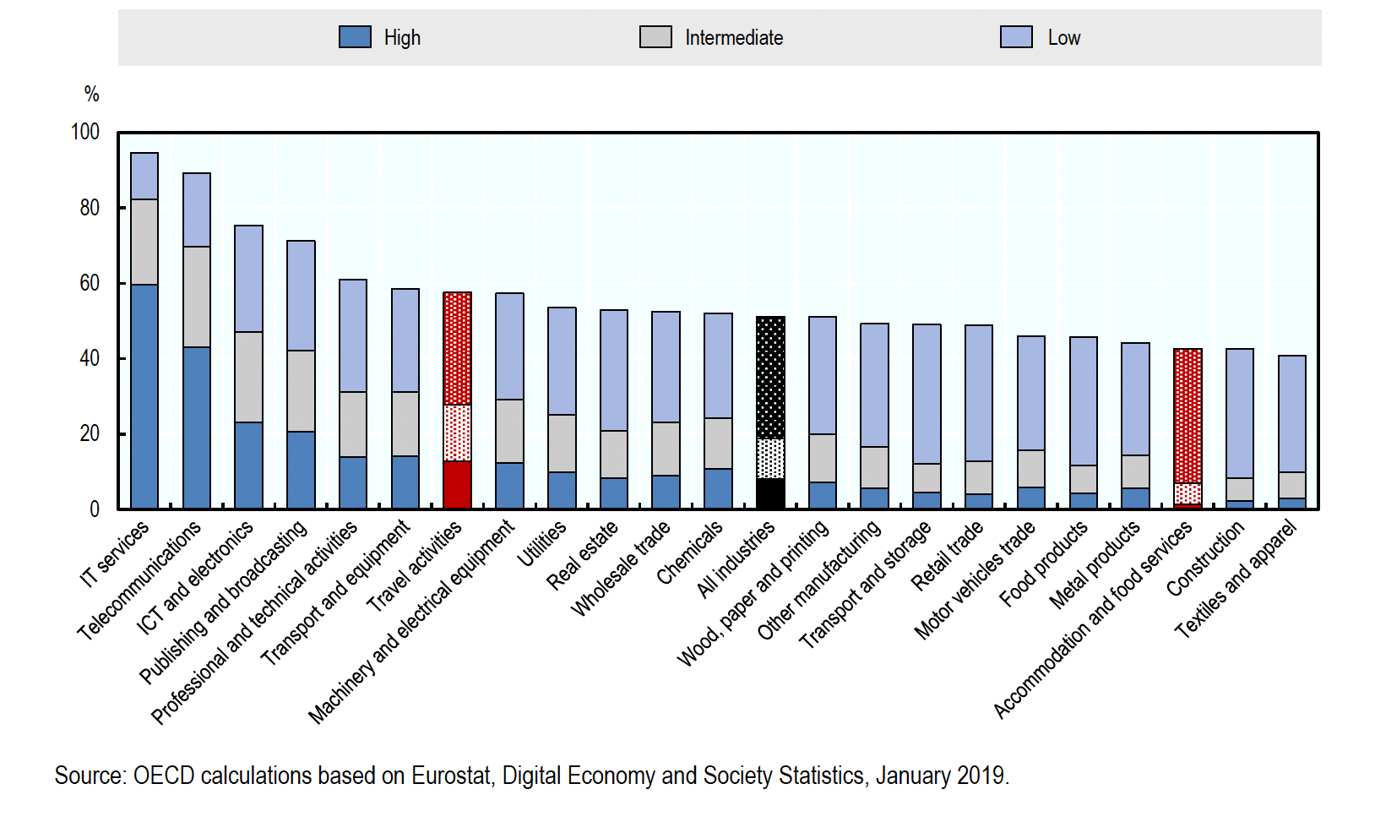
Enterprises with internal ICT capabilities by industry (EU countries)
As a percentage of enterprises with ten or more persons employed in each industry.

Slide 62
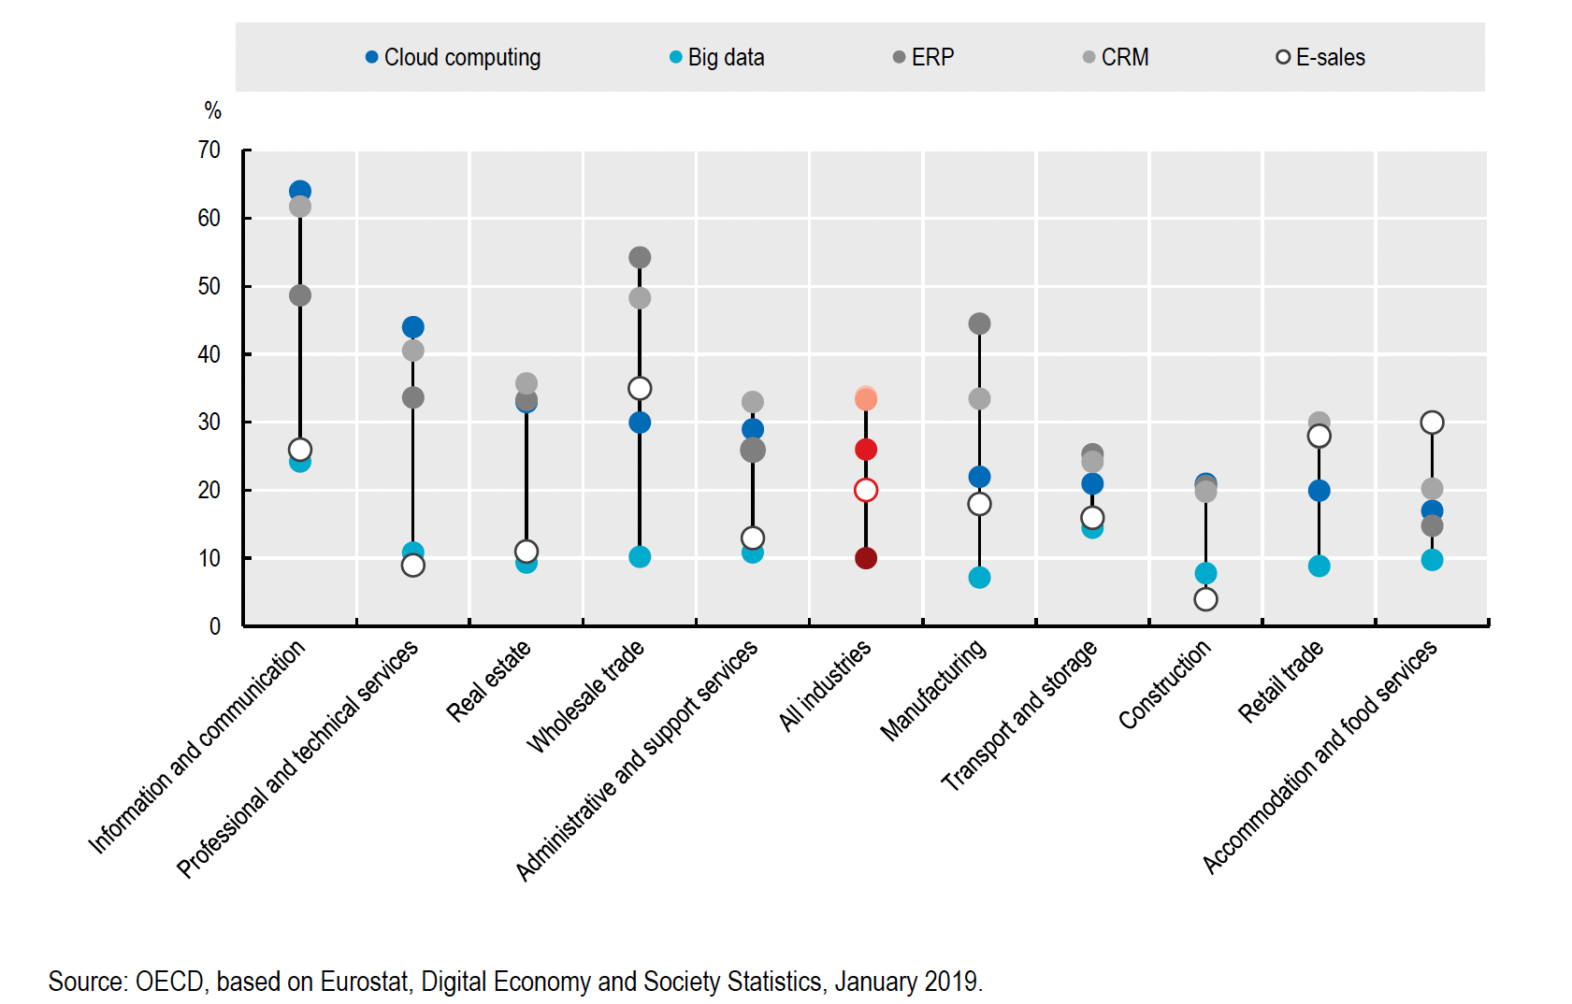
ICT uptake by industry (EU countries)
As a percentage of enterprises with ten or more persons employed in each industry.

Slide 63

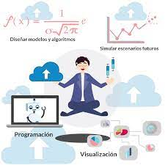


Roles of data leaders
 | STAGE 1: Destination Marketing | STAGE 2: Destination Management | STAGE 3: Destination Stewardship
Jobs | Marketing manager with data analytic function | Data analyst/data engineer + business analyst | Data analyst + data engineer + data scientist + business analyst + stakeholder – collaboration manager
Data analyst
They are specialized in the data analysis and interpretation.
Data engineer
Responsible for creating a reliable and efficient data architecture.
Data scientist
They take the data processed by data engineers and use it for further analysis.
Destination managers
They ensure that the data strategy is aligned with the destination's overall strategy and regulatory requirements.

Slide 64
Jobs
Survey on the future of work and skills development in tourism developed by UNWTO
1.400 interviews worldwide
Workers & Students
Public Sector
Companies
Educational institutions

Slide 65
Jobs

Slide 66
Jobs

Slide 67
CAPACITY

Slide 68
Cooperation in skills: Working together
There is a strong potential by the European Commission in promoting joint actions to maximise the impact of skills investment.
INITIATIVES
PACT FOR SKILLS: To promote upskilling and reskilling partnerships between different stakeholders. It aims to mobilise all relevant actors to pool their resources and support human development.
BLUEPRINT FOR SECTORAL COOPERATION ON SKILLS: It strengthens stakeholder efforts, and is funded by the Erasmus+ Programme. Under the blueprint, stakeholders work together in sector-specific partnerships, called alliances for sectoral cooperation for skills, which develop and implement strategies to address skills gaps in these sectors.
EUROPEAN ALLIANCE FOR APPRENTICESHIPS: It unites governments and key stakeholders with the aim of strengthening the quality, supply and overall image of apprenticeships across Europe. In the Youth Employment Support: a bridge to jobs for the next generation the Commission puts a renewed impetus on the European Alliance for Apprenticeships which will promote national coalitions, support SMEs and reinforce the involvement of social partners: trade unions and employers' organisations.

Slide 69
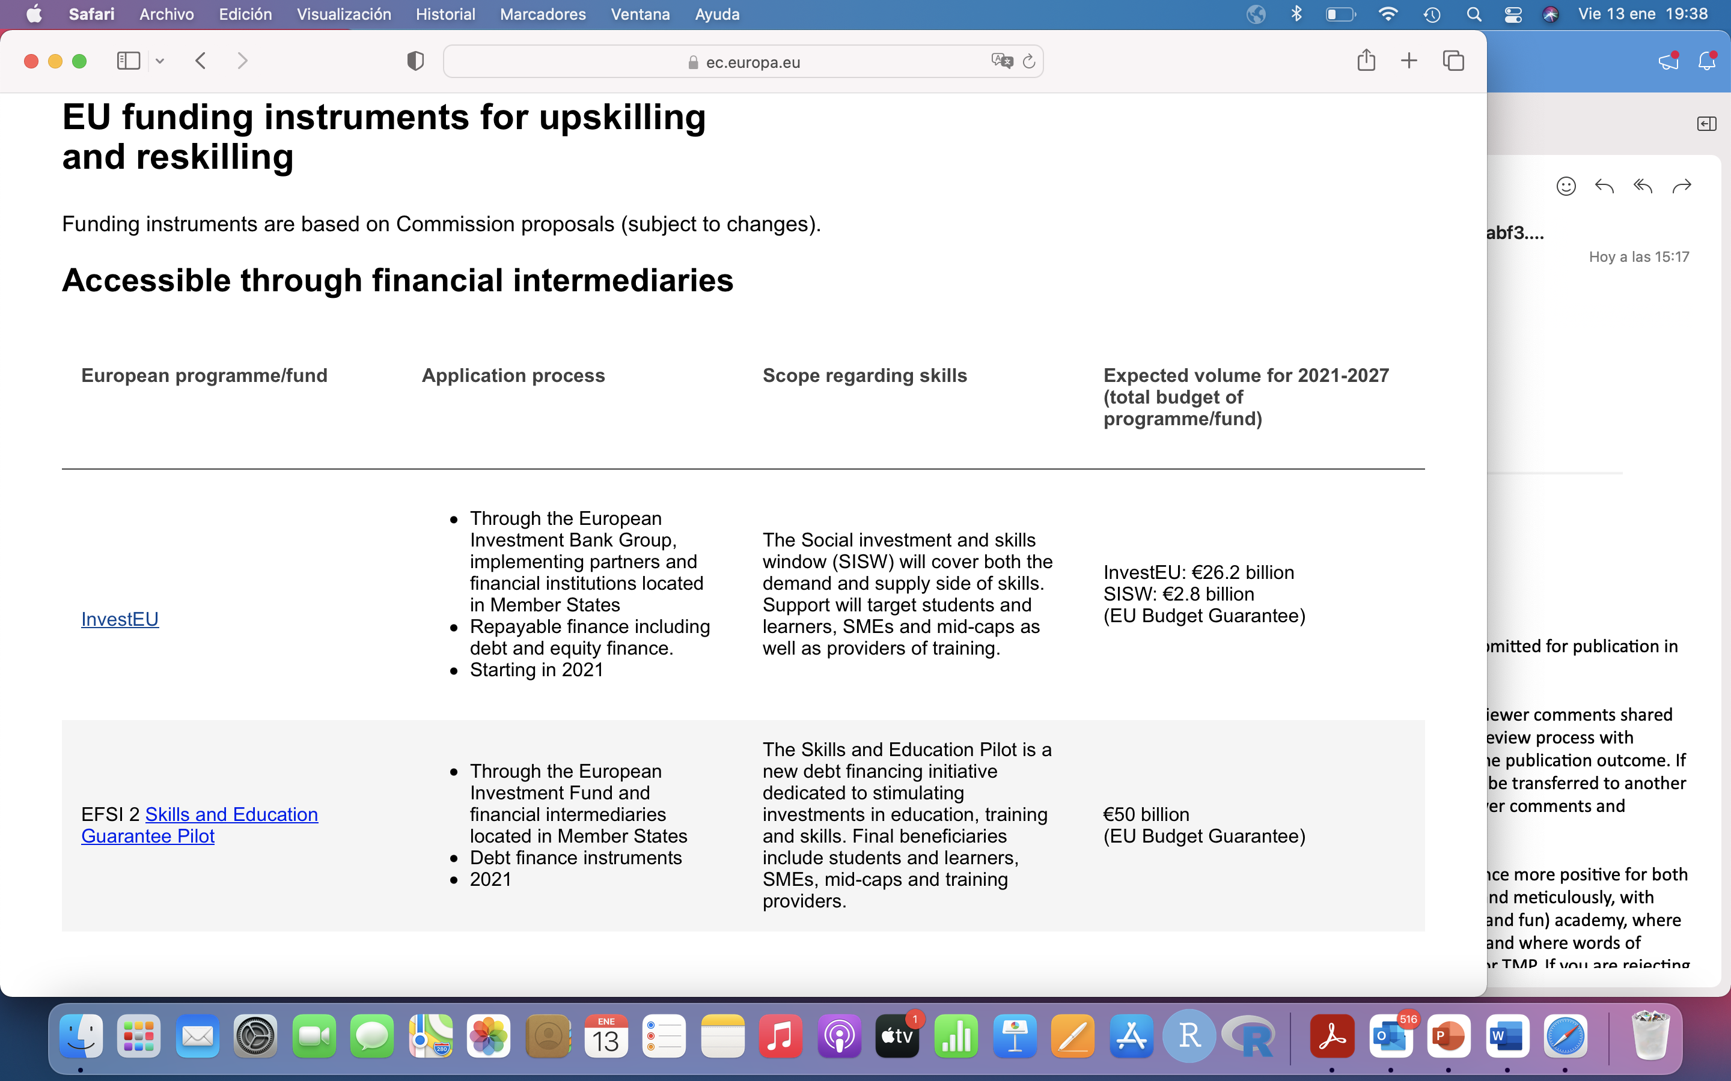
EU funding instruments for upskilling and reskilling
Accessible through financial intermediaries
InvestEU
EFSI 2 Skills and Education Guarantee Pilot

Slide 70
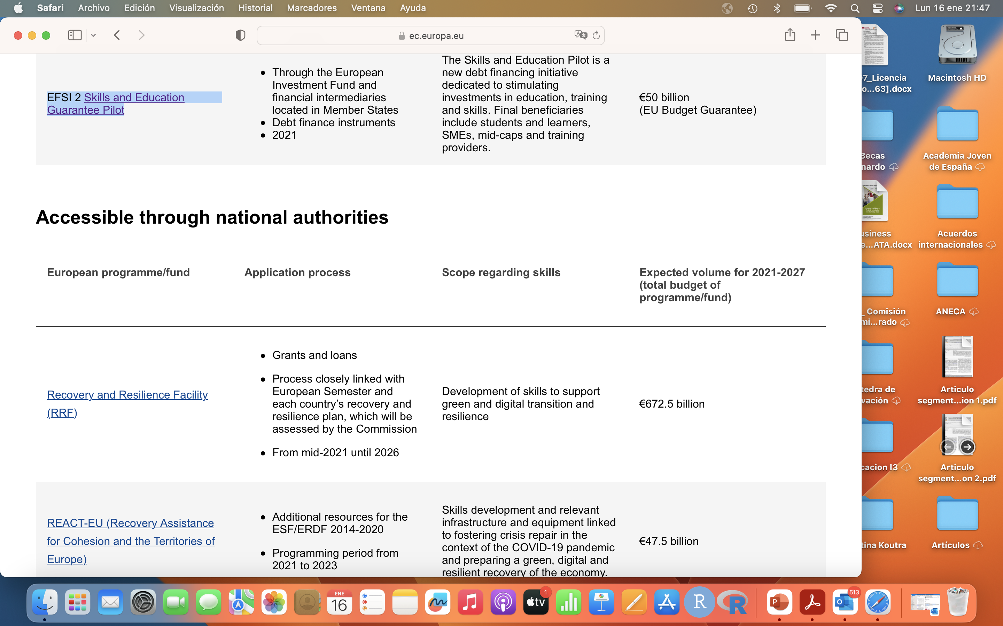
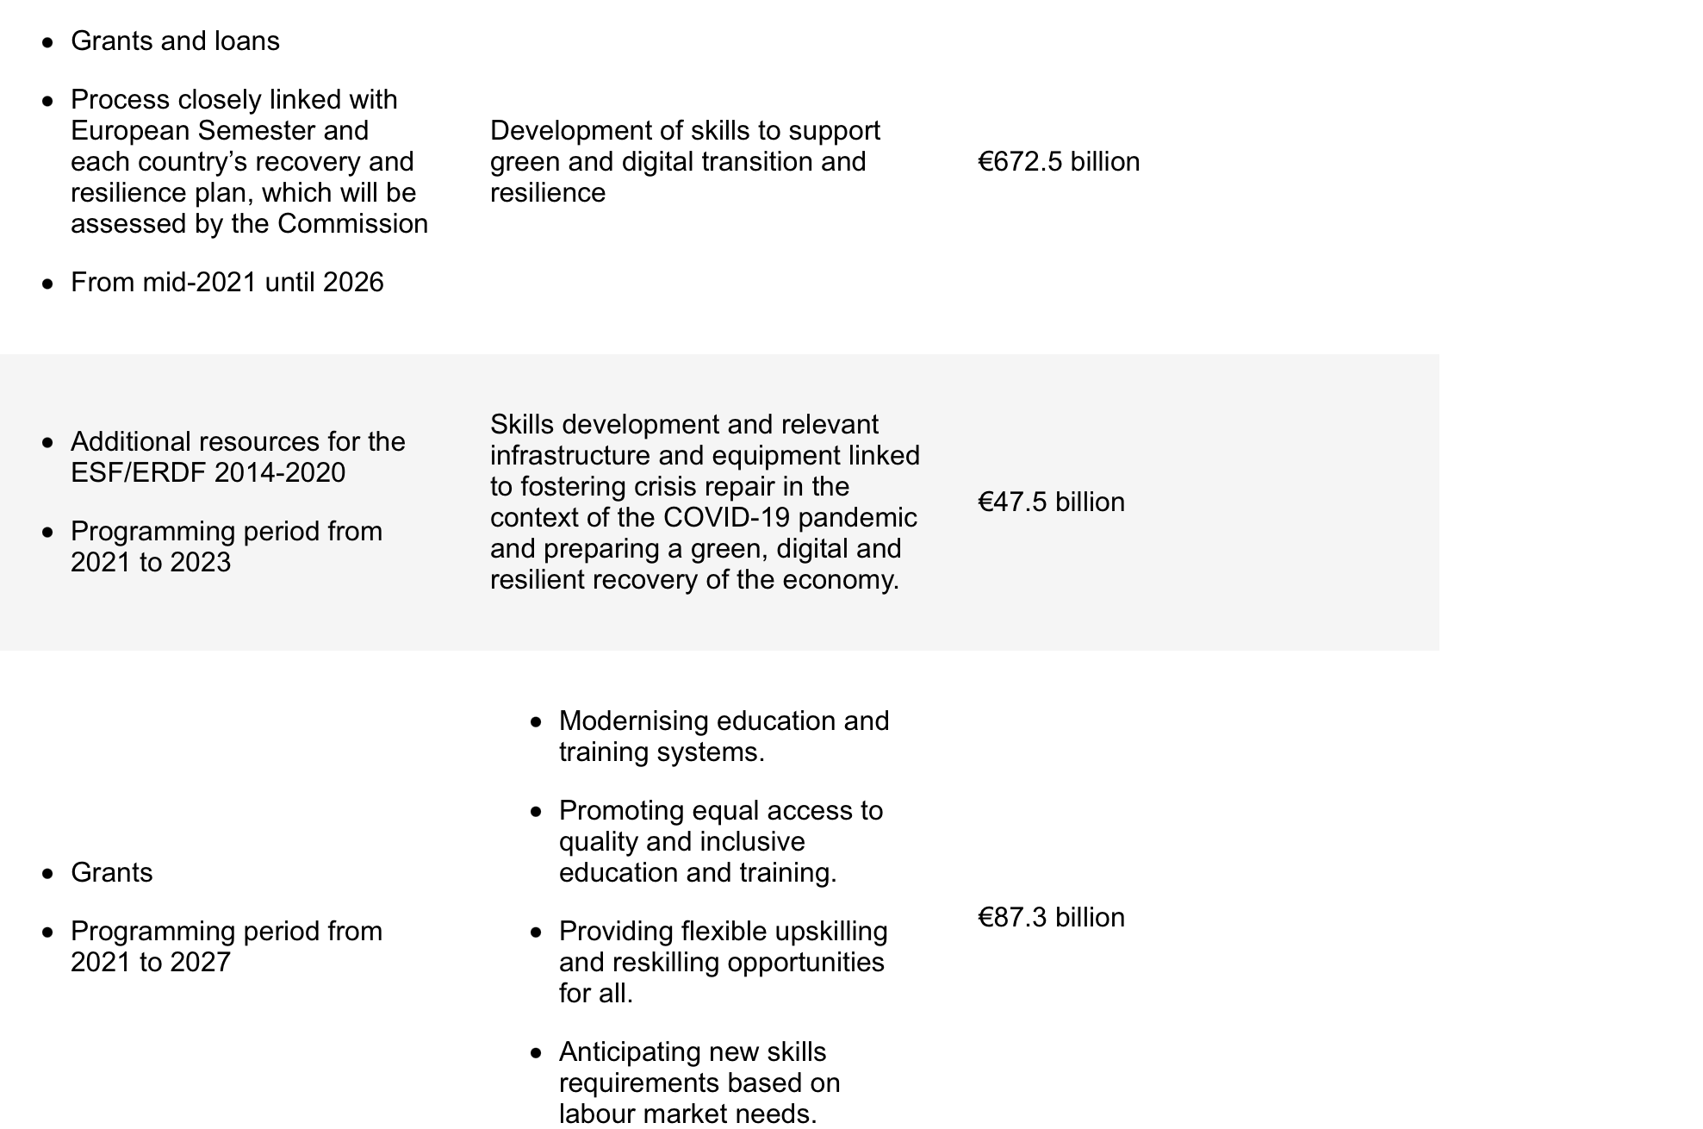
EU funding instruments for upskilling and reskilling
Accessible through national authorities
Recovery and Resilience Facility (RRF)
REACT-EU (Recovery Assistance for Cohesion and the Territories of Europe)
European Social Fund Plus (ESF+ under shared management)

Slide 71
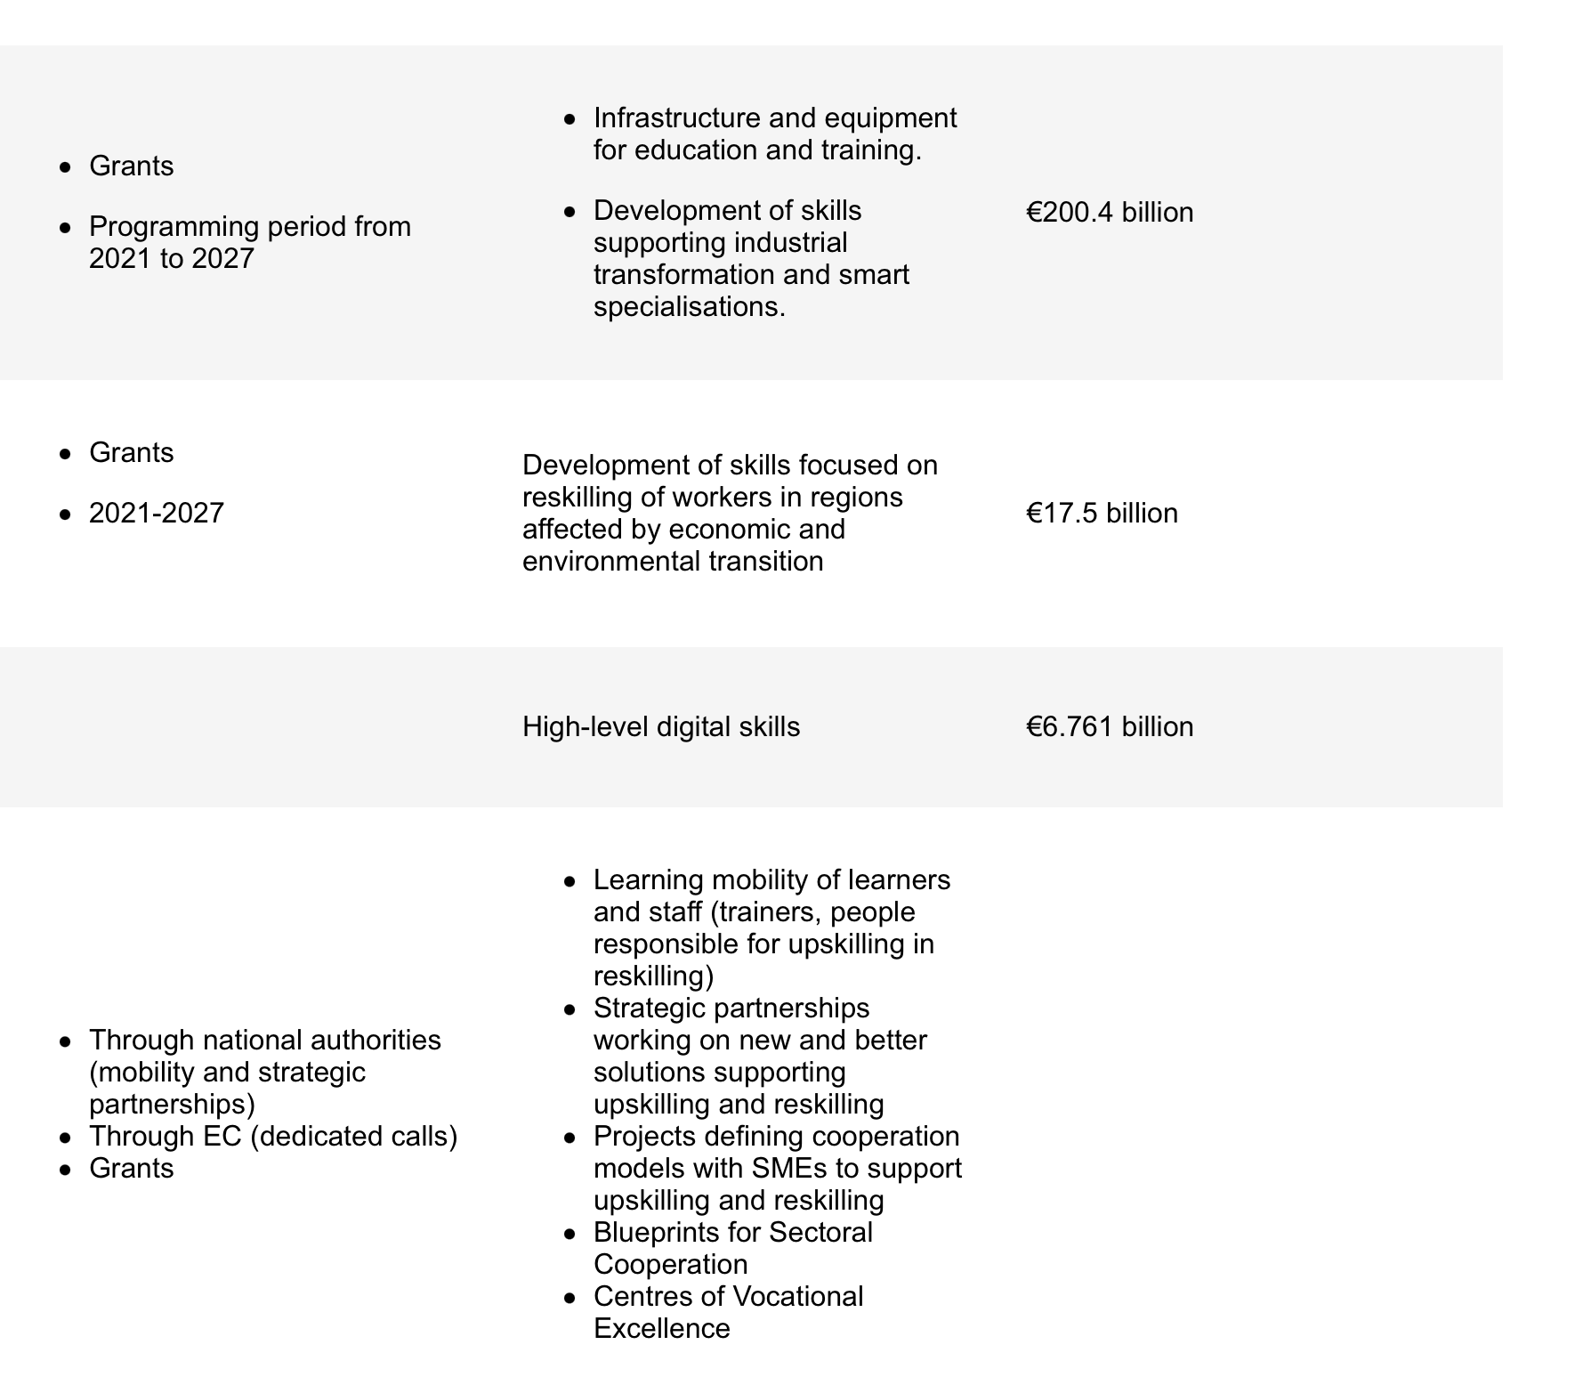
EU funding instruments for upskilling and reskilling
Accessible through national authorities
European Regional Development Fund (ERDF)
Just Transition Fund (JTF)
Digital Europe Programme
Erasmus+ (new MFF)

Slide 72
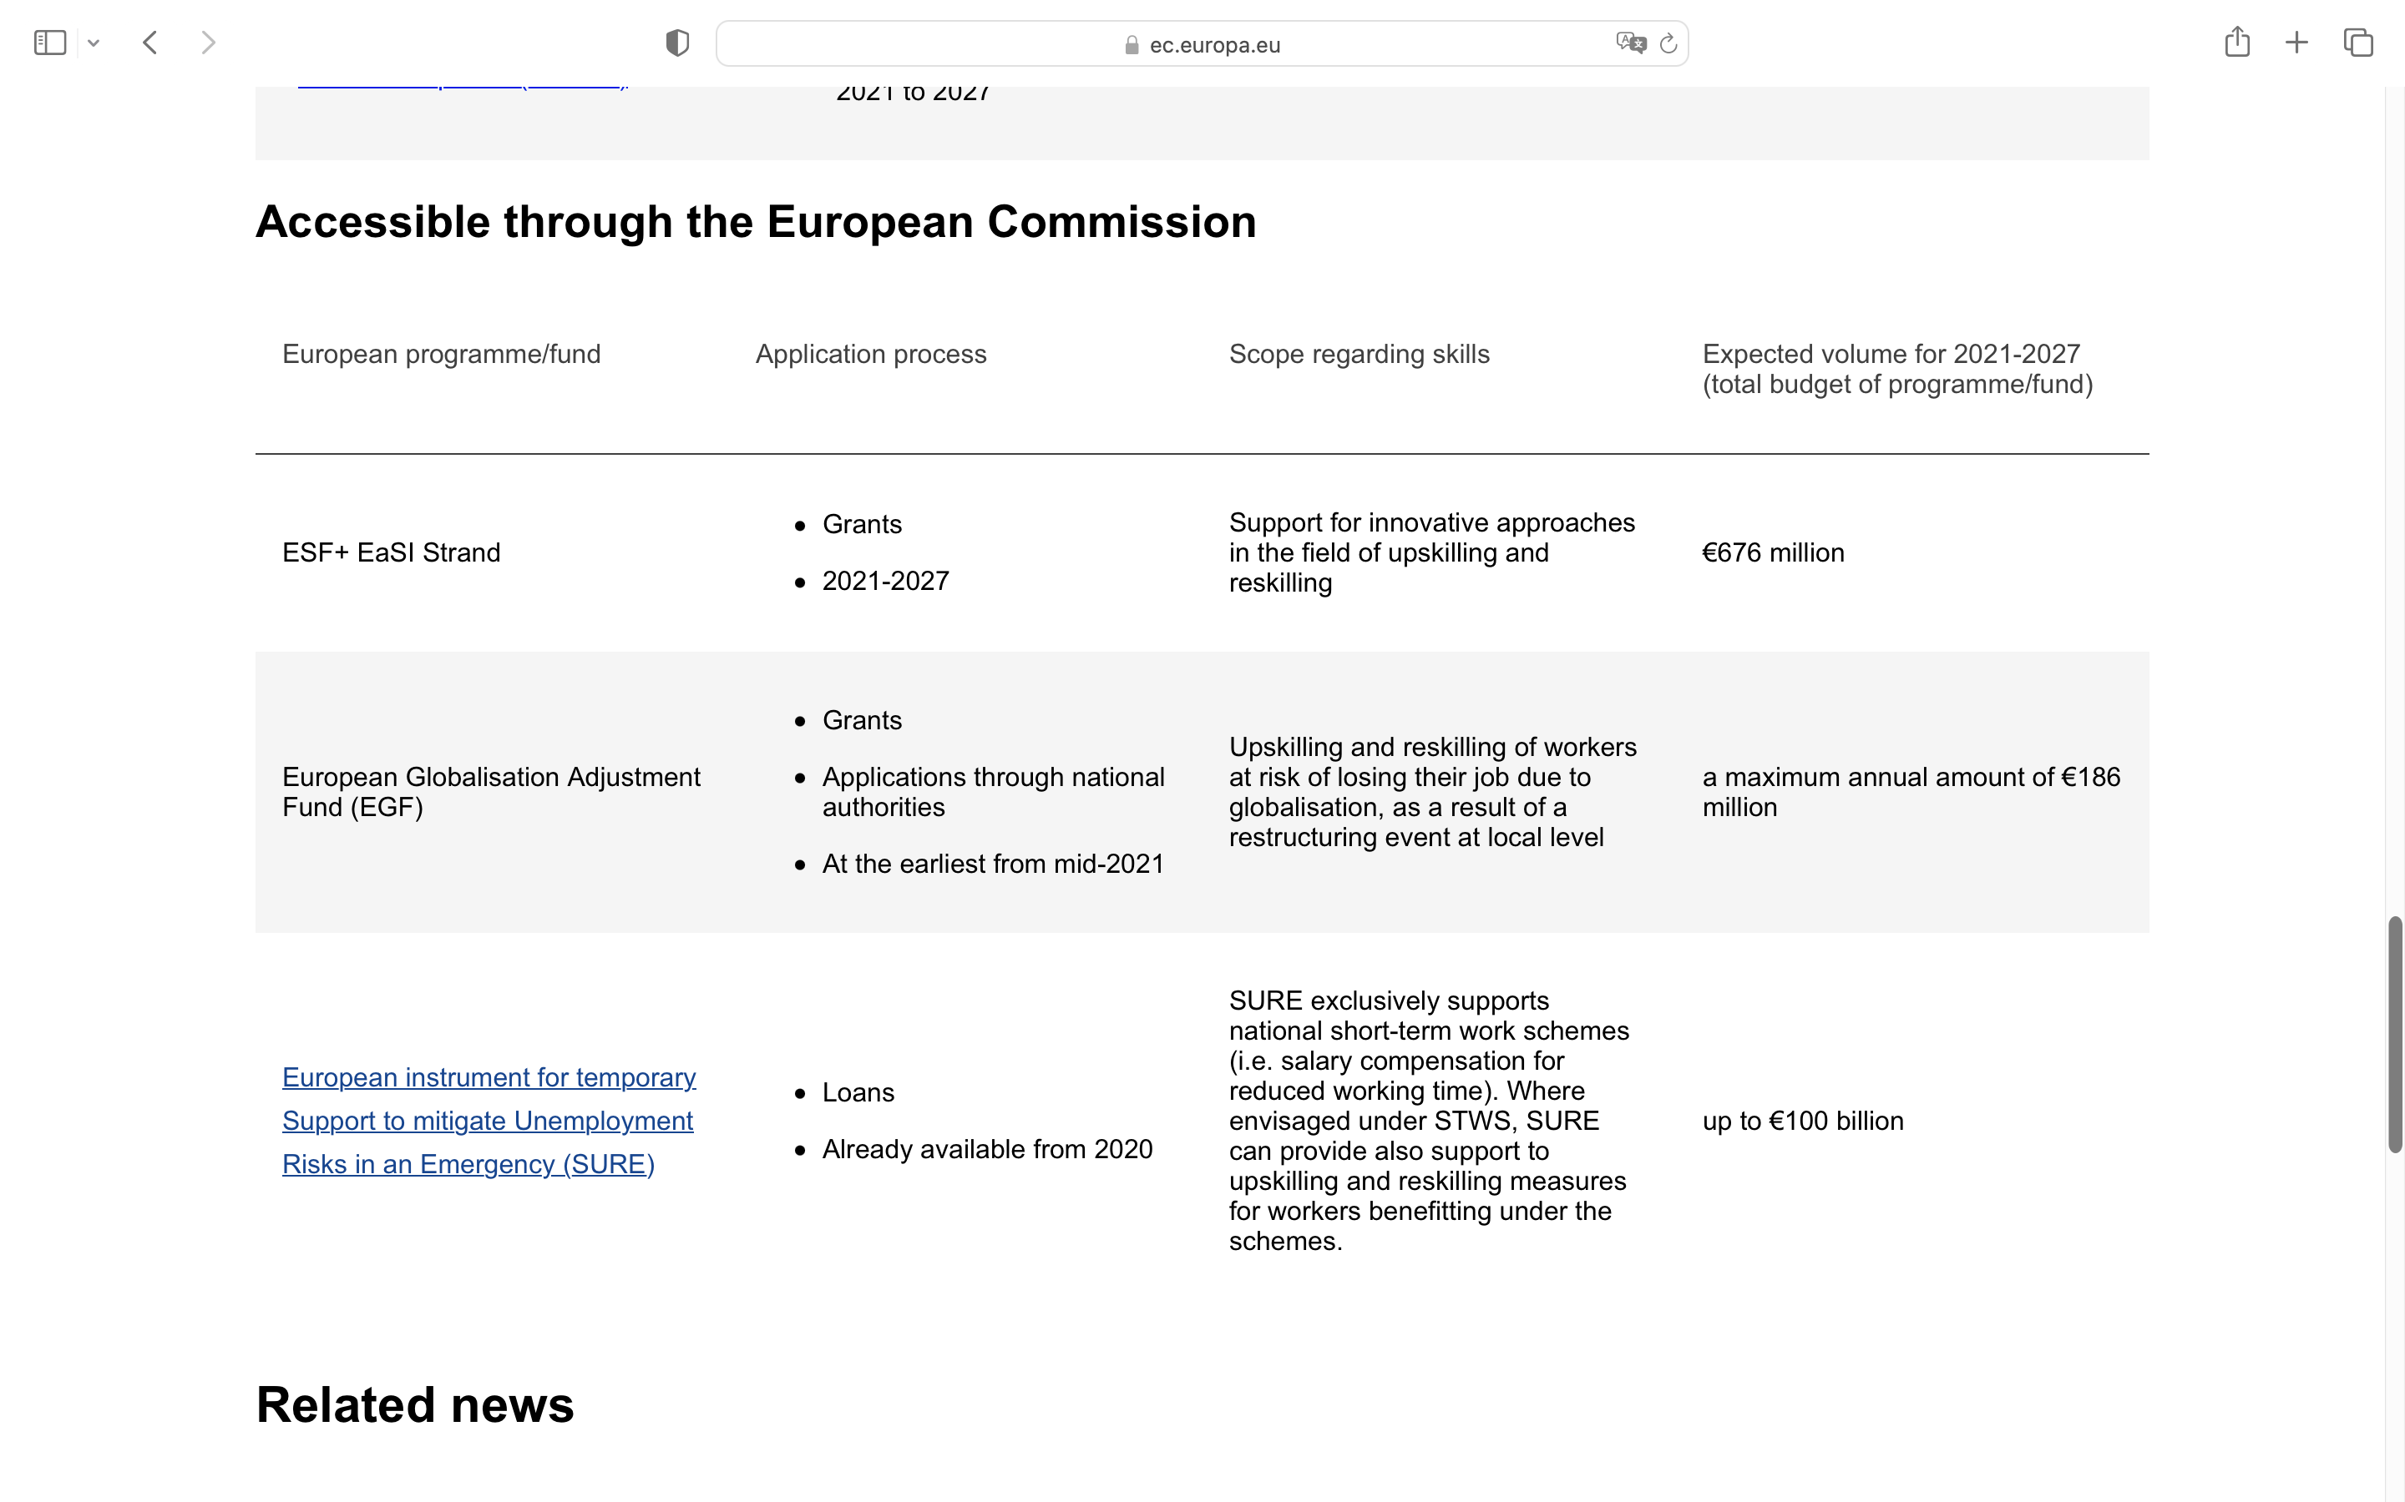
EU funding instruments for upskilling and reskilling
Accessible through the European Commission
ESF+ EaSI Strand
European Globalisation Adjustment Fund (EGF)
European instrument for temporary
Support to mitigate Unemployment
Risks in an Emergency (SURE)

Slide 73

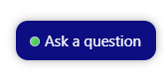
Q&A
To ask questions, please click on the button in the bottom right corner of your screen.
Write your question.
Then write your name to send it off.
10 minutes
Notes:
Q&A session, 10 minutes 12:15 – 12:25

Slide 74


Next steps
Activity | Title | Date | Time (CET)
Pillar 4 webinar: Knowledge transfer | Opportunities and tools for data and knowledge sharing: latest trends and possible solutions in Smart Tourism | 10/02/2023 | 11:30 – 12:30
Pillar 5 webinar: Ecosystem management | Data and tourism ecosystems: from mapping to managing | 11/04/2023 | 11:30 – 12:30
Link to the webinars: https://smarttourismdestinations.eu/webinars/
Pillar 3 & 4 workshop Only for selected Tourism Destinations! | How to improve the Human Capital and Skills of your Smart Tourism Destination and foster knowledge sharing | March | tbc

